Slide 1




MODULE 5
Computational thinking as an inclusion tool for disadvantaged adults
The COMPutational Seniors project is co-funded by the European Union. The views and opinions expressed in this document commit only to the author(s) and do not necessarily reflect those of the European Union or the Spanish Service for the Internationalization of Education (SEPIE). Neither the European Union nor the SEPIE National Agency can be held responsible for them.

Slide 2


WELCOME TO MODULE 5
In this module, we will explore how Computational Thinking can serve as a powerful tool for fostering digital inclusion among disadvantaged adults. As technology becomes more embedded in daily life, CT offers a structured way to help learners navigate digital challenges with confidence and independence.
We will look at how to support digital literacy in older adults by understanding the digital divide, addressing learning barriers, and adapting teaching strategies to their needs.
You will also learn how to tailor CT instruction to diverse learning styles and cultural contexts, making it inclusive and relevant for all adult learners.
Use this module to design inclusive CT activities that help
disadvantaged adults overcome digital barriers and participate
more confidently in today’s tech-driven world.

Slide 3
STRUCTURE OF THE MODULE
Unit 1. Digital literacy for seniors: overcoming the challenges of technological advancement
Unit 3. Adapting Computational Thinking for diverse adult learners
How to adapt Computational Thinking for diverse adult learners
Methods for tailoring concepts to meet the diverse needs of learners
Examples of hands-on activities
Understanding the digital gap in senior education
What makes learning effective for seniors?
The educator’s role in promoting digital literacy
Unit 2. The role of adult trainers in incorporating the CT approach
Unit 4. Case studies and activities
Real-world examples of CT
Interactive exercises to explore and apply what you have learn in this unit
Facilitating digital literacy, not just computer skills
Addressing the unique needs of adult learners
Promoting active and meaningful engagement

Slide 4
Understand the potential of computational thinking as a tool for social inclusion and empowerment of disadvantaged adults.
At the end of the course, the learner will be able to…
Learning outcomes
Determine how to adapt computational thinking concepts to meet the specific needs of disadvantaged or marginalized groups.
Identify the role of computational thinking in closing digital gap and providing new opportunities for employment and personal development of adult learners.
Demonstrate how to design inclusive educational approaches that make computational thinking accessible to all adult learners, regardless of their background.

Slide 5

MODULE AIM and OBJECTIVES
AIM: To explore how Computational Thinking can be used as a tool to foster digital inclusion among disadvantaged adult learners by promoting essential digital, cognitive and collaborative skills.
OBJECTIVES:
Understand the importance of digital literacy for disadvantaged adults and its link to CT.
Identify inclusive strategies trainers can adopt to support CT development in adult education.
Explore how CT can be adapted to diverse learning needs and contribute to bridging the digital divide.

Slide 6

UNIT 1
Digital literacy for seniors: overcoming the challenges of technological advancement
‹#›

Slide 7


The most effective learning occurs when adults are actively engaged in the process and see the relevance to their lives

Slide 8

Understanding the digital gap in senior education
In today's rapidly changing world, digital skills are becoming essential in every aspect of life. Senior citizens who are often excluded from technological progress, can feel lost and isolated.
Many senior citizens are aware that the world is changing, that technological and scientific progress is creating completely new tools and methods of using them and that the ways of reacting to reality that senior citizens have learned and developed may have become useless.
Hence the need for knowledge on how to find one's way in this reality, taking into account the individual circumstances of each person.

Slide 9
Understanding the digital gap in senior education
The educational opportunities available to senior citizens develop their passions and interests. Although it also responds to technical and civilizational progress, this is only a small fraction of the activities aimed at preparing older people for the progressive digitalization and the increasing importance of modern technologies in everyday life.
Although each new generation of older people is better prepared in terms of digital competence, it is not difficult to see that technological progress is far ahead of the cognitive abilities of senior citizens. This is due to the psycho-physical conditions that determine the ageing process.
That is why it is so important – especially in non-formal and informal education of adults, including seniors – to adapt methods and forms of education to the conditions and perception abilities of older people.

Slide 10
What makes learning effective for seniors?
Adults learn effectively through practice, experience and independent problem solving. The effectiveness of this method of adult learning is emphasized by geragogy (educational gerontology, pedagogy of ageing), which emphasises the use of methods in adult education that differ from those commonly used in pedagogy.
The aim is to use methods that are suitable for the proper adaptation to old age and the objective cognitive changes and life functions that are characteristic of it. The older adults are, the more experienced they are, the more often they are affected by short-term memory problems. The preferred method of educating adults, and in particular the elderly, are active methods and individualized forms of learning, which allow them to adjust the pace of learning to their own circumstances and to draw on their own life experience.

Slide 11
The educator’s role in promoting digital literacy
The ubiquity of digital technologies is changing the nature of the problems that adults, including seniors, face on a daily basis. When searching for solutions, they have to analyse complex information, compare a lot of different data and use technological devices. This is where computational thinking comes in handy, teaching logical reasoning and enabling effective problem solving in various areas of life.
In such an education, as described above, the role of the educator must also change: from a teacher, lecturer, expert to a trainer, and even more so - a mentor, tutor, facilitator using such methods - known from pedagogy and andragogy - which are able to ensure the durability of the educational effects of older people.

Slide 12
Desired outcomes of adult learning
Seeking truth
The theory of adult learning outlines a set of desired outcomes that focus on enhancing the learning process and addressing the needs and experiences of adult learners.
04
Mature adults focus on understanding the root cause of a situation to find lasting solutions
Self-knowledge
Personality
01
Understanding adults' needs and goals promotes self-awareness and growth
05
Focus on their own strengths and learn skills that align with their goals to reach their full potential
Global citizenship
Essential values
02
Learn to respect differing views, promote empathy, and support others
06
Adults should respect and understand the shared values that bind their society together
Positive attitude
Social order
03
Embracing change builds resilience and turns every moment into a learning opportunity
Adults must contribute to society by understanding its rules and demonstrating intelligence for positive change
07

Slide 13


Differentiation in adult learning
CT can be adapted to support adult learners with diverse backgrounds, varying levels of digital literacy, and different learning styles. Not all learners have the same level of comfort with technology, and CT strategies should be accessible to everyone, regardless of their experience with digital tools. By differentiating instruction, you can ensure that learners engage with CT concepts in ways that align with their abilities. This flexibility fosters an inclusive learning environment where all adults, including those with limited digital literacy, can develop essential problem-solving and critical thinking skills.
Key strategies for differentiation:
Assess individual needs
Use multiple teaching methods
Provide flexible options
Adjust pacing
Understand their knowledge, goals, and challenges to tailor instruction effectively.
Do visual, auditory, and hands-on activities to address different learning styles.
Allow them to choose project topics or demonstrate understanding in diverse ways.
Offer flexibility in the pace of learning, giving students the opportunity to progress at their own speed.
CT is a methodology that fosters inclusion by allowing educators to adapt learning strategies to different abilities, backgrounds and levels of experience. By adjusting instruction to individual needs, CT makes learning accessible for everyone, including those with low digital literacy or different learning styles.

Slide 14
UNIT 2
The role of adult trainers in incorporating the CT approach
‹#›

Slide 15
Trainers and educators play a vital role in bridging the digital divide for senior citizens and empowering them to actively participate in today's digital world.
Their responsibilities extend beyond simple technical instruction. They must foster genuine digital literacy and employ a pedagogical approach informed by Computational Thinking.

Slide 16
The role of adult trainers in incorporating the CT approach
Facilitating digital literacy, not just computer skills
Addressing the unique needs of adult learners, especially seniors
Promoting active and meaningful engagement
The focus shouldn't solely be on how to use technology, but on why and when.
Trainers need to adapt their teaching methods, taking into account the specific challenges faced by adult learners, especially senior ones.
By fostering active learning not passive activity like simply listening to a lecture or watching a demonstration, trainers can ensure that seniors not only acquire digital skills but also develop the confidence and competence to use technology meaningfully in their daily lives.

Slide 17

Addressing the unique needs of adult learners
Trainers need to adapt their teaching methods, taking into account the specific challenges faced by adult learners, especially seniors:
Pace and patience
Learning should be gradual and adapted to individual learning paces. Trainers need to be patient, providing ample time for practice and repetition.
Multimodal learning
Utilize a variety of learning methods (visual aids, hands-on activities, group discussions) to cater to different learning styles and address potential age-related cognitive changes.
Accessibility and inclusivity
Ensure all materials are accessible, using clear fonts, appropriate audio levels, and providing alternative formats (large print, audio versions) as needed.
Many adult learners (especially seniors) approach technology with apprehension. Trainers must create a safe and supportive learning environment that encourages exploration and experimentation without judgment.
Addressing fears and anxieties

Slide 18
Promoting active and meaningful engagement
Digital competence training should not be seen as a passive activity. Trainers need to:
Relate digital skills to adult learners' interests and daily lives. For example, show how using the internet can help them connect with family, access healthcare information, or engage in hobbies.
Contextualize learning
Encourage collaboration
Promote peer-to-peer learning and group activities. This can help build confidence and provide mutual support among learners.
Celebrate successes
Regularly acknowledge and celebrate adult learners' progress, fostering the sense of accomplishment and encouraging continued learning.
Ongoing support
Provide ongoing support and resources beyond the initial training program. This might include online help, regular workshops, or community-based support groups.

Slide 19
UNIT 3
Adapting Computational Thinking for diverse adult learners
‹#›

Slide 20
This unit focuses on adapting CT instruction to meet the diverse needs of adult learners.
We will explore strategies for tailoring CT concepts, incorporating cultural relevance, and accommodating different learning styles to create engaging and effective learning experiences for all.
We will explore how to make CT accessible and relevant for all adult learners, regardless of their background, learning style, or prior experience with technology.
The best teachers are those who show their students how to think,
not what to think

Slide 21

How to adapt Computational Thinking for diverse adult learners
As you see from the previous modules, Computational Thinking is a powerful problem-solving approach, but its effectiveness hinges on accessibility and relevance for all adult learners.
To ensure inclusivity and maximize impact, you must tailor CT concepts and activities to meet the diverse needs of our adult learners, especially if you, as a trainer work with disadvantaged adults (e.g. economic, social, educational, etc. ).

Slide 22



How to adapt Computational Thinking for diverse adult learners
To do this you should take into consideration at least the following aspects:
Tailoring concepts
Cultural relevance
Learning styles and preferences

Slide 23
Adapting Computational Thinking for diverse adult learners
Tailoring concepts
Cultural relevance
Learning styles and preferences
It means to simplify complex concepts that are crucial for making CT accessible to diverse adult learners.
It means to incorporate culturally relevant examples and contexts that are essential for making CT meaningful and engaging for diverse adult learners.
It means to recognise diverse learning styles that are key for effective CT education in the learning process for adult learners.

Slide 24

The methods for tailoring concepts to meet the diverse needs of learners
Chunking information
Break down complex concepts into smaller, manageable chunks. Instead of presenting the whole algorithm at once, introduce it step-by-step, allowing learners to grasp each part before moving on.
Visual aids
Use visual aids like diagrams, flowcharts, and animations to illustrate abstract concepts. Visual learners will particularly benefit from these representations.
Analogies and real-world examples
Relate Computational Thinking concepts to familiar real-world situations. For example, explain algorithms using the analogy of a recipe or a set of instructions for assembling furniture.

Slide 25
The methods for tailoring concepts to meet the diverse needs of learners
Storytelling and narrative
Use storytelling techniques to make complex concepts more engaging and memorable. A narrative can help learners connect with the information on an emotional level, improving understanding and retention.
Hands-on activities
Engage learners through hands-on activities that allow them to experience Computational Thinking concepts in a tangible way. Creating interactive stories using block-based programming or designing flowcharts for everyday tasks can make the concepts more relatable.
Use of different modalities: Provide the use of various learning modalities to cater to different learning styles. Include visual, auditory and kinesthetic activities to enable maximum engagement.

Slide 26
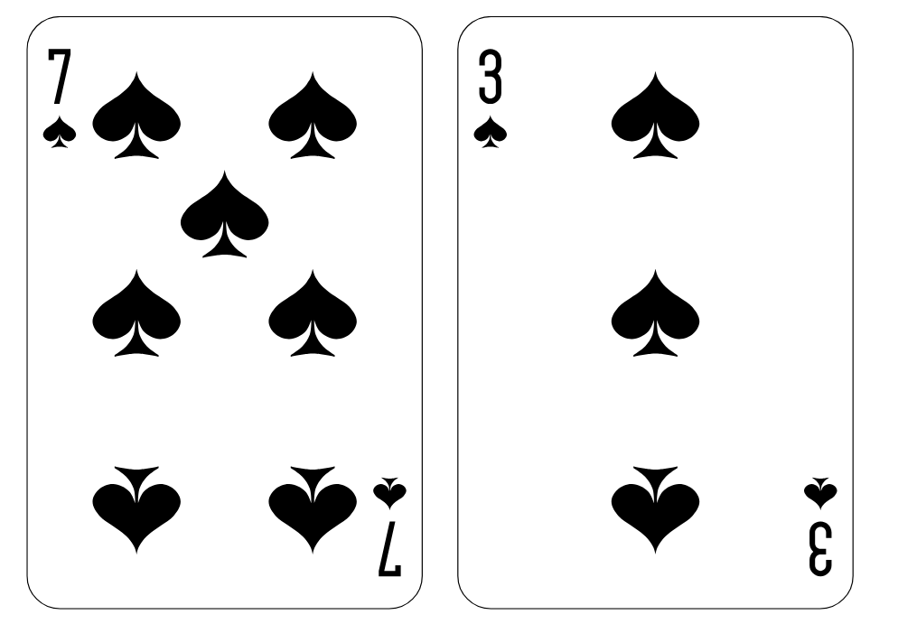
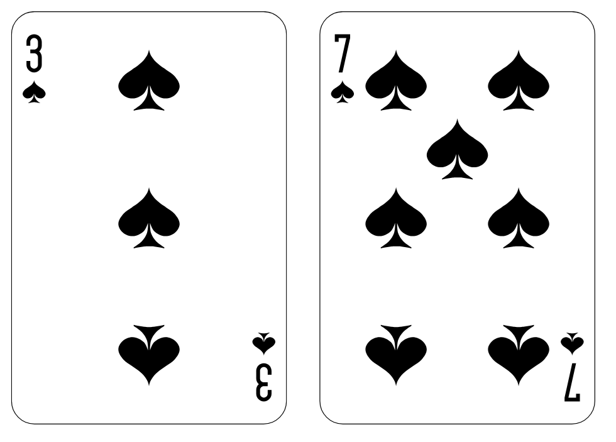
Practical example for chunking information
  The core idea: Comparing Adjacent Pairs
  Imagine you have a deck of cards unsorted by number, which you have to arrange in order from the smallest to the largest. The simplest way to sort them would be to compare pairs of adjacent cards. If the order is wrong (a larger card is before a smaller one), you swap them. You repeat this process for all pairs, going through the whole deck.
  Visual Aid
  Step 1 compare two unsorted cards
  Show an image of two unsorted cards (e.g., a 7 and a 3).
  Then, show the cards swapped to the correct order (3 and 7).
vs

Slide 27
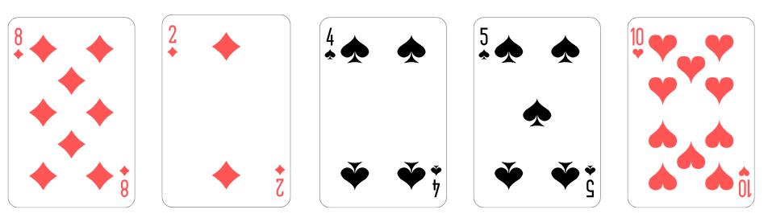
Practical example for chunking information
  Step 2 compare two unsorted cards
  We have a small list of numbers: [8, 2, 4, 5, 10].
  We’ll make one pass through the list, comparing adjacent pairs and swapping them if needed:
  Compare 8 and 2. Swap them: [2, 8, 4, 5, 10]
  After one pass, the largest number (10) is in its correct position. However, the rest of the list is still unsorted. We need to repeat this process, making multiple passes through the list.
  Compare 8 and 4. Swap them: [2, 4, 8, 5, 10]
  Compare 8 and 5. Swap them: [2, 4, 5, 8, 10]
  Compare 8 and 10. No swap needed: [2, 4, 2, 8,10]

Slide 28
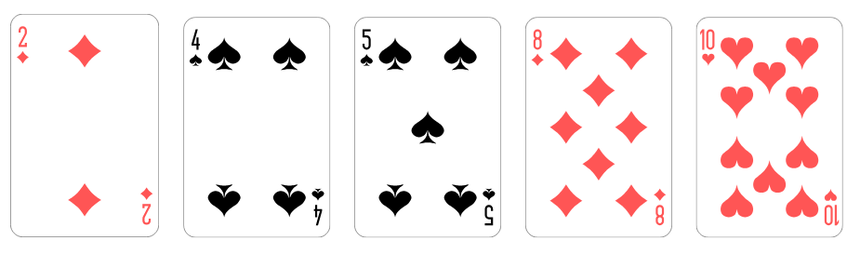
Practical example for chunking information
Show the steps for a second and a third pass, highlighting how with each pass, more numbers move to their correct positions. Show how fewer comparisons are needed in subsequent passes as the largest numbers bubble up.
Once the basic steps are understood, you can introduce the full algorithm or relate it to similar sorting mechanisms learners might already be familiar with (e.g., sorting physical objects).
By breaking down the sort into these smaller, logical steps, adult learners can build a solid understanding of the concept before tackling its full complexity. The visual aids at each step ensure understanding and make the process less abstract and daunting. This approach is applicable to numerous other CT concepts.

Slide 29

Examples of hands-on activities: daily tasks viewed
through the lens of CT method
Decomposition
Planning a meal: Breaking down the task of preparing a meal into smaller subtasks: making a shopping list (data gathering), checking the pantry for ingredients (data analysis), following a recipe (algorithm), chopping vegetables (subroutine), cooking the meal (process), and cleaning up (post-process).
Organizing a closet: Dividing the task into steps such as sorting items by type (categorization), removing unwanted items (data filtering), grouping similar items (clustering), and arranging them neatly on shelves (spatial organization).
Pattern Recognition
Identifying a traffic pattern: Recognizing recurring patterns in daily commutes, such as rush hour congestion or slower traffic on certain days of the week, to predict commute times and plan accordingly.
Noticing weather patterns: Observing daily weather changes to identify recurring patterns (e.g., rain on weekends, sunny mornings) and anticipate future weather conditions.
Abstraction
Summarizing a news article: Extracting the main points from a news article, ignoring unnecessary details, to grasp the central message.
Creating a mental to-do list: Representing tasks needed to be done today as a simplified list, focusing on essential information rather than granular details.
Algorithms
Following a workout routine: Executing a series of exercises in a specific order, representing a sequence of steps (an algorithm).
Baking a cake: Following a precise recipe (algorithm), a sequence of steps, to achieve a desired outcome.

Slide 30

The methods for Cultural relevance to meet the diverse needs of learners
Selecting relevant scenarios
Use examples and scenarios from learners' everyday lives, cultural traditions, and community contexts. For example, use a traditional game or a local festival as a basis for computational thinking.
Using diverse characters and settings
Feature characters and settings that reflect the learners' diverse backgrounds and experiences. This helps learners relate to the material and feel a sense of ownership.

Slide 31
The methods for Cultural relevance to meet the diverse needs of learners
Incorporating indigenous knowledge systems
Draw connections between CT principles and traditional knowledge systems relevant to learners’ cultural heritage. This can demonstrate the universality of CT principles and highlight the value of indigenous knowledge.
Translation and localization
If learners speak a different language than the primary instruction language, provide translated materials or employ bilingual instructors.

Slide 32

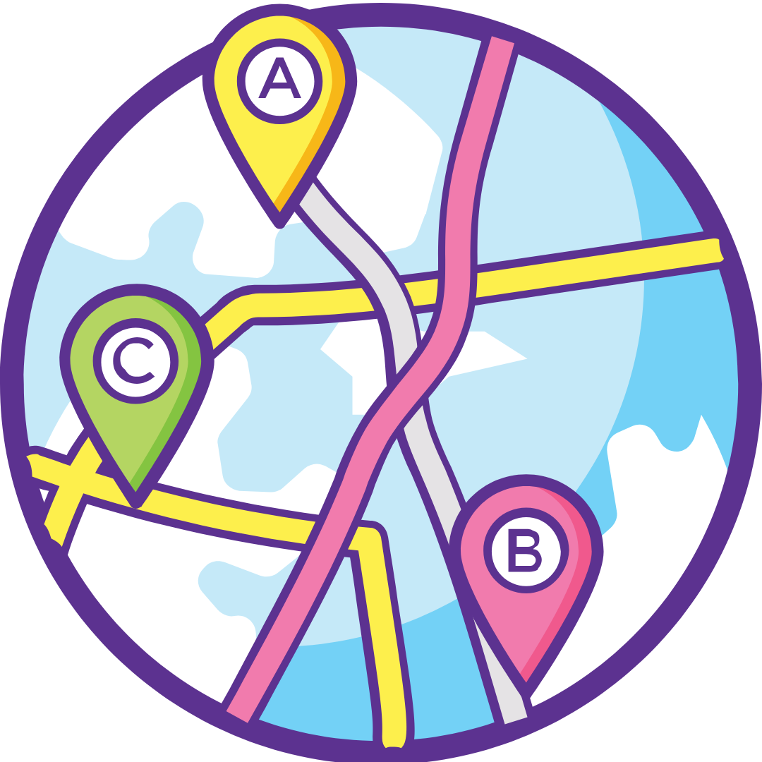


Practical example for Cultural relevance
To make Computational Thinking concepts relatable and engaging for diverse learners, we need to ground them in familiar contexts. Here are some real-life examples based on cultural traditions and community settings:
Everyday life scenarios
Cooking recipe
Explain algorithms using the analogy of a cooking recipe. Each step in the recipe is an instruction, and the order of steps is crucial for the final outcome. This is applicable across cultures, as most people have experience with following recipes.
Planning a route
Use map navigation as an example of graph traversal. The map is a graph, roads are edges, and intersections are nodes. Finding the shortest route from home to work involves searching the graph to find the optimal path.
Managing finances
Analyse a personal budget or a simple expense tracking sheet to illustrate data analysis concepts. Learners can calculate totals, averages, and identify trends in their spending habits.
Scheduling appointments
Explain scheduling algorithms using the context of planning a busy day with multiple appointments. Learners explore different approaches to optimizing the schedule and minimizing conflicts.

Slide 33




Practical example for Cultural relevance
To make Computational Thinking concepts relatable and engaging for diverse learners, we need to ground them in familiar contexts. Here are examples drawing from everyday life, cultural traditions, and community settings:
Cultural traditions
Weaving patterns
Analyse traditional weaving patterns to illustrate concepts of pattern recognition and repetition. This could be adapted to other craft traditions, like quilting, knitting, or pottery
Traditional games (game design and logic)
Use rules and strategies from traditional games (e.g., Mancala, Checkers, Go) to teach game design principles and logical reasoning.
Storytelling and folktales (sequencing and storytelling)
Analyze the structure and sequencing of events in folktales or myths to explain concepts of narrative and storytelling. This helps learners see the logical flow in a familiar and engaging way.
Traditional music and/or dances (rhythm and patterns)
Explore the rhythmic and melodic patterns in traditional music or the steps and sequences in traditional dances
to illustrate concepts of pattern recognition and repetition.

Slide 34




Practical example for Cultural relevance
To make Computational Thinking concepts relatable and engaging for diverse learners, we need to ground them in familiar contexts. Here are real-life examples based on cultural traditions and community settings:
Community contexts
Community events planning
Discuss project management concepts using the context of planning a community event, like a festival.
Adult learners can explore the tasks involved, dependencies, and scheduling to complete the project successfully.
Public transportation routing (optimization)
Analyze public transportation routes to illustrate optimization problems. Adult learners can find the shortest route, the most efficient route, or the route that minimizes transfers.
Recycling and waste management (data collection and analysis)
Use data on community recycling or waste management to illustrate data collection and analysis techniques. Learners can identify trends, make predictions, and propose solutions for improving waste management.
Community gardens (planning and resource allocation)
Design with Adult learners a community garden layout, considering factors like sunlight, water availability, and plant spacing. This introduces concepts of resource allocation and optimization.

Slide 35

The methods of learning styles and preferences to meet the diverse needs of learners
To recognise diverse learning styles of learners and use a variety of activities and teaching methods to meet different preferences of learners is a key element for effective CT education.
The most common learning styles:
Visual learners
Auditory learners
Kinesthetic learners
Read/write learners
Emphasize visual aids, diagrams, flowcharts, and mind maps
Use verbal explanations, discussions, and audio recordings, explain their problem-solving strategies verbally.
Involving hands-on activities, engaging in role-playing exercises.
Use written instructions, worksheets, and presentations.
Offer both individual and collaborative learning opportunities.
Some adult learners are better in individual work, while others thrive in group settings.

Slide 36
Adapting Computational Thinking for diverse adult learners
These are some real-life examples taken from everyday situations, cultural traditions, and community settings that can be use for explaining Computational Thinking concepts to adult learners.
It is important to remember to adapt these examples to the specific cultural and community context of adult learners. The aim of this approach is to make the abstract concepts of Computational Thinking relevant, engaging, and accessible for learners.
By thoughtfully tailoring CT concepts, incorporating cultural relevance, and addressing diverse learning styles, trainers and/or educators can create inclusive and engaging learning experiences that empower all adult learners to develop essential Computational Thinking skills.

Slide 37
UNIT 4
Case study and activities
‹#›

Slide 38


Case Study 1. How to choose an online banking service using Computational Thinking methods?
Background:
In this case study we would like to demonstrate how can apply computational thinking (CT) methods to effectively select an online banking service that meets our financial needs and preferences. We will outline how we can use CT techniques to navigate the decision-making process of choosing an online banking service.
Let's see step-by-step process using Computational Thinking
Problem Decomposition:
Identify the Decision:
The primary task is to choose an online banking service.
Break Down the Problem: Consider factors such as fees, security features, customer support, mobile app functionality, and interest rates. This step involves listing all possible criteria that are important for selecting a banking service.
Example factors to be consider:
Monthly maintenance fees
ATM access and network
Interest rates on savings and loans
Security measures (e.g., two-factor authentication)
Customer service options (chat, phone, email)
Availability of features like budgeting tools

Slide 39


Case Study 1. How to choose an online banking service using Computational Thinking methods?
Pattern Recognition:
Research and Compare:
Gather information on different online banking services. Look for reviews, ratings, and comparisons across various platforms.
Identify Patterns:
Analyze the data for trends, such as common features available among top-rated banks or frequently mentioned customer service experiences.
Data Sources you can use:
Bank websites
User reviews on forums or social media platforms
Abstraction:
Focus on Key Criteria:
From the detailed list of factors, prioritize the most critical ones that align with personal financial goals and needs. For example, if personal budgeting tools are essential, those banks offering robust budgeting features should be emphasized.
Simplify Choices:
Narrow down options to a manageable number. Perhaps create a shortlist of three to five banks based on the initial research.

Slide 40


Case Study 1. How to choose an online banking service using Computational Thinking methods?
Algorithmic Thinking:
Create a Decision-Making Process:
Develop a systematic approach for evaluating the shortlisted banks.
This could involve:
Scoring banks based on the established criteria (e.g., 1-10 for each factor).
Weighting certain criteria higher based on personal importance (e.g., security features may have a higher weight than monthly fees).
Calculate the overall score for each bank.
Sample Evaluation Table:
Bank | Fees | Security | Customer Support | Features | Total Score
Bank A | 8 | 9 | 7 | 9 | 33
Bank B | 6 | 8 | 9 | 6 | 29
Bank C | 7 | 7 | 8 | 8 | 30
Decision Making:
Analyze Results:
Review the total scores and qualitative factors to make an informed decision.
Select a Bank:
Choose the online banking service with the highest score alongside any other critical qualitative considerations.

Slide 41
Case Study 1. How to choose an online banking service using Computational Thinking methods?
Conclusion
By applying computational thinking methods, adults can systematically select an online banking service that best fits their needs. This structured approach not only enhances decision-making efficiency but also empowers individuals to make informed choices based on their unique financial situations.
This case study illustrates how computational thinking can be a practical tool for navigating decisions in personal finance.

Slide 42

Case Study 2. Board Game „Rummikub” as a example to enhance CT in seniors
Objective: To learn how board games can be utilized as a tool to promote computational thinking (CT) skills among seniors, fostering critical thinking, problem-solving, and social interaction.
Background: Engaging seniors in board games invites cognitive activity, encourages strategic thinking, and facilitates social connections, which are essential for mental wellness.
Rummikub is a classic tile-based game that combines elements of strategy and luck. Players aim to form numbered sets and runs of tiles, making it ideal for illustrating computational thinking concepts.
  CT phase
  Skill Development
  Game Mechanics
Decomposition
  Players must break the game down into smaller tasks, such as focusing on their hand of tiles and determining possible moves.
  Each turn involves deciding which tiles to play, requiring players to analyze their options based on current board configurations.
Pattern Recognition
  Seniors learn to identify patterns within their tiles, such as recognizing numerical sequences or matching colors.
  As players become familiar with common combinations, they begin to anticipate opponents' moves and potential strategies, enhancing their ability to recognize patterns in gameplay.
Abstraction
  Abstraction involves focusing on the significant elements of the game (like tile values) while ignoring less relevant details (like the playful design of the tiles).
  Players must prioritize which tiles to retain or discard based on potential plays, enabling them to simplify complex decisions into actionable strategies.
Algorithms
  As players decide how to play their tiles, they create sequences of actions (strategies) that lead to winning outcomes.
  Players develop algorithms by systematically evaluating and executing their plays based on current game constraints, fostering logical reasoning.

Slide 43
Case Study 2. Board Game „Rummikub” as a example to enhance CT in seniors
Outcomes:
Cognitive Engagement: The game stimulates mental faculties, helping to maintain cognitive health and prevent decline in seniors.
Social Interaction: Playing in groups fosters communication, collaboration, and relationship-building, which are key to emotional wellbeing.
Strategic Thinking: Seniors enhance their critical thinking and decision-making abilities as they analyze their gameplay and adapt to opponents.
Enjoyment and Motivation: The enjoyable nature of board games encourages continued participation and learning, making computational thinking accessible and fun.
Conclusion:
This case study demonstrates how board games like Rummikub can effectively promote computational thinking skills among seniors. By engaging them in strategic gameplay, seniors can enhance their cognitive capabilities while enjoying a social experience. This approach not only contributes to their mental agility but also reinforces the importance of lifelong learning and interaction within the community.

Slide 44

PRACTICAL EXERCISES
Examples of hands-on workshop ideas demonstrating computational thinking principles, tailored for adult learners and emphasizing active participation
‹#›

Slide 45
Hands-on workshop ideas demonstrating computational thinking principles
In this section there are three examples of hands-on workshop ideas demonstrating computational thinking principles, tailored for adult learners and emphasizing active participation.
These workshops emphasize active participation, visual aids, and real-world applications to make computational thinking concepts more engaging and accessible for adult learners.
Remember to adapt the complexity and materials to your specific audience's needs and prior knowledge. Post-workshop discussions are crucial for reinforcing learning and fostering critical thinking.

Slide 46
Workshop 1
Workshop 1: Recipe redesign (Decomposition, Algorithm Design, Evaluation)
Objective: To understand algorithm design and decomposition through recipe modification.
Materials: Various recipes (simple to complex), whiteboards or large paper, markers.
Activity:
Introduction: Briefly discuss algorithms and decomposition.
Recipe selection: Participants choose a recipe.
Decomposition: Break down the recipe into individual steps (decomposition).
Algorithm Design: Write the steps as a clear algorithm, including conditions (e.g., "If the oven is preheated, then proceed to step 4"). Use flowcharts for visual representation.
Recipe redesign: Modify the recipe (e.g., substituting ingredients, adjusting cooking times). Re-write the algorithm to reflect the changes.
Evaluation: Discuss the feasibility of the modified recipe and algorithm. What worked well? What could be improved?

Slide 47
Workshop 2
Workshop 2: City planning challenge (Abstraction, Pattern Recognition, Algorithm Design)
Objective: To practice abstraction, pattern recognition, and algorithm design through urban planning.
Materials: Maps of a city (or a simplified city grid), building blocks or cutouts representing different building types (residential, commercial, industrial), colored markers.
Activity:
Introduction: Discuss abstraction (simplifying complex systems) and pattern recognition.
City analysis: Examine the provided map. Identify patterns in land use, transportation networks, and population density.
Abstraction: Decide which features to include in a simplified model of the city.
Algorithm Design: Develop a simple algorithm for allocating different building types to different zones in the model city based on patterns observed.
City building: Use building blocks to create a model city based on the algorithm.
Evaluation: Evaluate the model city. Does it effectively reflect the observed patterns? Are there any areas for improvement in the algorithm or city design?

Slide 48
Workshop 3
Workshop 3: Image filtering (Abstraction, Algorithm Design)
Objective: To understand image filtering through a simplified simulation.
Materials: Simple grid drawings (e.g., 5x5 grid representing pixels), colored pencils or markers.
Activity:
  Introduction: Discuss the concept of image filtering (e.g., blurring, sharpening) as a process applied to individual pixels.
  Abstraction: Represent images with simple grid drawings. Each cell/pixel has a color.
  Algorithm Design: Develop a simple algorithm for blurring an image (e.g., averaging the color of adjacent pixels).
  Image filtering: Apply the algorithm to the grid drawing using colored pencils/markers.
  Evaluation: Compare the original image to the filtered image. Discuss the effect of the algorithm.

Slide 49
SUMMARY
This module explored how Computational Thinking can be used as a tool for digital inclusion, particularly for disadvantaged or low-skilled adults who face barriers in accessing and using technology.
We examined the role of CT in supporting digital literacy and autonomy, with a focus on older adults and those with limited prior digital experience.
The module introduced practical strategies to adapt CT instruction to different learning styles, cultural contexts and accessibility needs.
You also saw how CT activities can help learners build confidence, navigate everyday digital tasks, and engage more fully in society. Through inclusive practices and real-life examples, the module highlighted how CT can support not only digital skills, but also equity, empowerment, and lifelong learning.

Slide 50

CALL TO ACTION:
Reflect on what you’ve learned:
How can storytelling and visual narratives support Computational Thinking development?
What are effective ways to design and implement CT activities using storytelling?
How can trainers support adult learners in creating and sharing digital stories?

Slide 51
GLOSSARY
Computational Thinking or CT: Solving problems like a computer would, step-by-step.
Decomposition: Breaking a big problem into smaller parts.
Abstraction: Focusing only on the important details.
Pattern Recognition: Spotting trends or things that repeat.
Algorithm: A set of instructions to complete a task.
Iteration: Repeating a process to improve it.
Unplugged Activities: Learning CT without screens using games, puzzles, etc.
Debugging: Finding and fixing errors in a process.
Soft Skills: Non-technical abilities that help people work well with others and adapt to challenges.
Gamification: Using game elements (like points or challenges) in learning.
Digital Literacy: Knowing how to use digital tools safely and effectively.
Inclusion: Making learning accessible to everyone, no matter their background.
Scaffolding: Supporting learners step-by-step so they can gradually do more on their own.

Slide 52
REFERENCES
Mills K., Coenraad M., Ruiz P., Burke Q., Weisgrau J. (2021). Computational Thinking for an Inclusive World: A Resource for Educators to Learn and Lead , Digital Promise, December 2021
Porzak R., Psomos P. Computer-based thinking in the work of teachers and schools, Lubelska Akademia WSEI, 2023
Computational Thinking Competencies, ISTE, 2025
Gałuszka G. ‘Wirtualna jesień życia. Rozważania o roli gier cyfrowych w życiu osób starszych’ (Virtual autumn of life. Reflections on the role of digital games in the lives of the elderly), Wydawnictwo AGH, Kraków 2023, available at: https://www.wydawnictwo.agh.edu.pl/produkt/1364-wirtualna-jesien-zycia
Kwiatkowski J. Methodological basis for educating senior citizens in digital competences using gaming: A guide for educators. Fundacja Małopolska Izba Samorządowa, 2024
thetech.org/bowersinstitute

