Slide 1




MODULE 2
Why is it important to teach Computational Thinking?
Challenges and opportunities in promoting computational thinking in low-qualified adult education
The COMPutational Seniors project is co-funded by the European Union. The views and opinions expressed in this document commit only to the author(s) and do not necessarily reflect those of the European Union or the Spanish Service for the Internationalization of Education (SEPIE). Neither the European Union nor the SEPIE National Agency can be held responsible for them.

Slide 2


WELCOME TO MODULE 2
In this module, we explore why teaching Computational Thinking is not just relevant but necessary when working with adults, particularly those with low formal qualifications.
CT can play a powerful role in improving lifelong learning opportunities, boosting confidence, and fostering inclusion in an increasingly digital society.
You’ll examine the challenges that adult educators face in this context, as well as the potential that CT holds when applied through accessible and engaging strategies.
Use this module to rethink how we teach and make learning
more meaningful, relevant and motivating for adults in a
fast-changing world.

Slide 3
STRUCTURE OF THE MODULE
Unit 1. Understanding the context: adult learning challenges in Europe
Unit 3. Challenges and opportunities in promoting CT in adult education: adopting engagement strategies
Labour market and education data in the EU
Gaps in access to upskilling opportunities
Trends in adult learning fields
Barrier's adult learners face
Importance of engagement and inclusion
Practical strategies to promote CT effectively
Unit 2. Understanding the meaning of CT in 21st century
Unit 4. The impact and potential of CT on low-qualified adults
Importance of CT in a digital and AI-driven society
Applications of CT across education and diverse industries
CT and cognitive development: Bloom’s Taxonomy and levels of thinking
Enhancing employability through CT-related skills like problem-solving and critical thinking
Promoting digital inclusion and AI literacy through CT
Applying CT principles in daily life for personal and professional empowerment
Unit 5. Case studies and activities
Real-world examples of CT
Interactive exercises to explore and apply what you have learn in this unit

Slide 4
Describe the importance of Computational Thinking (CT) in the 21st Century.
Determine challenges faced by low-qualified adults in accessing and applying CT in real-world scenarios.
At the end of the course, the learner will be able to…
Learning outcomes
Distinguish opportunities for the CT integration into adult education to enhance employability.
Acknowledge the strategies by promoting CT in adult education contexts.
Demonstrate impact and potential of CT on low-qualified adults.
Notes:
Describe the meaning of computational thinking (CT) and its relevance to the personal and professional growth of low-qualified adults in the 21st century.
Determine the challenges faced by low-qualified adults in accessing and applying computational thinking in real-world scenarios.
Identify opportunities and strategies to integrate computational thinking into adult education programs to enhance employability and lifelong learning.
Acknowledge the role of partnerships and community-based initiatives in promoting computational thinking education among underprivileged groups.
Demonstrate the application of computational thinking principles, such as problem-solving and decision-making, in addressing everyday challenges faced by adult learners.

Slide 5

MODULE AIM and OBJECTIVES
AIM: to provide knowledge about the importance of CT integration into adults education process by evaluating the challenges and opportunities, disclosing the impact and potential.
OBJECTIVES:
To justify the meaning of CT in the 21st century.
To present challenges and opportunities in promoting CT, emphasizing the strategies of learners’ engagement.
To disclose the impact and potential of CT on low-qualified adults.
Notes:
Lockwood, J., & Mooney, A. (2017). Computational thinking in education: Where does it fit? A systematic literary review. arXiv preprint arXiv:1703.07659.
Ortiz, J. S., Moreira, C., Menezes, K., Ferrari, B., Silva Junior, D., & Pereira, R. (2023). Computational Thinking and Mental Models: Promoting Digital Culture in the Youth and Adult Education. Interacting with Computers, 35(2), 91-104.

Slide 6

UNIT 1
Understanding the context: adult learning challenges in Europe
‹#›

Slide 7
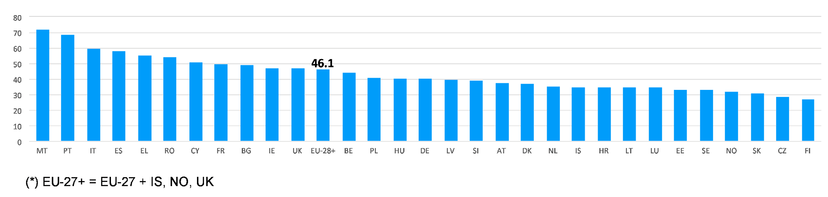
46% of adults could upskill. Are we ready to meet the challenge?
According to 2020 Cedefop, 128 million adults in the UK, Iceland, Norway and the EU-27 Member States have the capacity to reskill and upskill, which is nearly half (46.1%) of the adult population in all of these countries.
Low-skilled adults in the EU-27, Iceland, Norway and the UK, 2020
Cedefop calculation on LFS 2016, CSIS 2015, OECD PIAAC 2012, 2015.
Source: Cedefop 2020
This highlights the scale of adults who could benefit from digital skills and structured problem-solving methods like CT.
Notes:
https://www.cedefop.europa.eu/en/blog-articles/challenges-and-opportunities-low-skilled-adults-changing-labour-markets

Slide 8
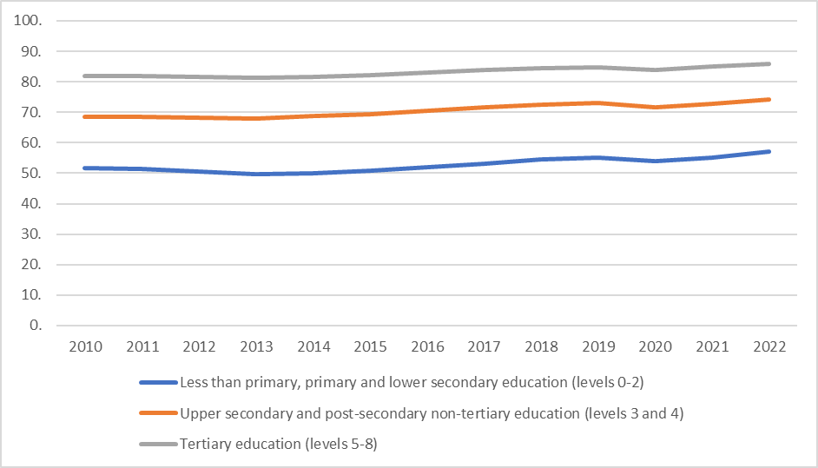
Is education the key to employment?
Low-skilled adults are at risk of unemployment, yet they benefit the least from upskilling and re-skilling opportunities.
Labour market data reveals a clear gap: adults with low qualifications consistently show much lower employment rates compared to those with higher education levels.
This makes it essential to develop training strategies that actively reach and engage those most at risk of being left behind.
Employment rate of educational attainment level
Less than primary, primary and lower secondary education (levels 0-2)
Upper secondary and post-secondary non-tertiary education (levels 3 and 4)
Tertiary education (levels 5-8)
Source: Labour Force Survey
Notes:
https://www.cedefop.europa.eu/en/blog-articles/challenges-and-opportunities-low-skilled-adults-changing-labour-markets

Slide 9
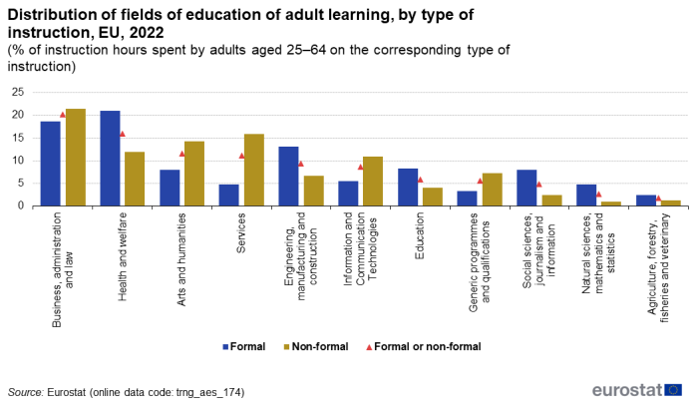
Nearly half of EU adults are learning but … in what fields?
The proportion of adults aged 25 to 64 years in the EU who participated in education or training during the previous 12 months was 46.6 %.
The main fields are:
Business, administration and law
Health and welfare accounted
Arts and humanities
Services
Engineering, manufacturing and constructions
ICT
Generic programmes and qualification
Distribution of fields of education of adult learning, by type of instruction, EU, 2022
(% of instruction hours spent by adults aged 25-64 on the corresponding type of instruction)
Health and welfare
Engineering manufacturing and construction
Information and Communication Technologies
Social sciences, journalism and information
Arts and humanities
Natural sciences, mathematics and statistics
Business, administration and law
Services
Education
Agriculture, forestry, fisheries and veterinary
Generic programmes and qualifications
Formal
Non-formal
Formal or non-formal
Source: Eurostat
Notes:
https://ec.europa.eu/eurostat/statistics-explained/index.php?title=Adult_learning_statistics_-_characteristics_of_education_and_training

Slide 10
UNIT 2
Understanding the meaning of CT in 21st century
‹#›

Slide 11

This unit “Understanding the meaning of CT in 21st century” presents the significance of Computational Thinking in adult education, emphasizing its relevance in today's digital society or, currently called, AI-driven society.
It begins by establishing the importance of CT, highlighting its role in fostering problem-solving, adaptability and analytical skills essential for navigating technological advancements.
While often associated with the IT sector, CT is widely applied across various industries. This unit presents its practical applications in fields such as business and finance, agriculture, supply chain management and others, demonstrating how CT helps solve real-world challenges.
Additionally, the development of CT knowledge is framed within Bloom’s Taxonomy, focusing on cognitive skills such as remembering, understanding, applying, analyzing, evaluating, and creating. These competencies enable adult learners to critically assess information, develop innovative solutions, and effectively integrate CT methods into professional and everyday life.
‹#›

Slide 12


CT in education: expanding the reach
What is Computational Thinking, and why has it become so important in modern education?
Let’s explore how CT is used in schools and why it’s time to bring it into adult learning too.
CT has become an essential part of K–12 education because of its usefulness. It introduces learners to a structured approach to problem-solving that includes basic programming concepts, logical thinking and mathematical reasoning.
CT also helps students understand how to break down complex systems into smaller parts, including abstract ones like components of a robot, encouraging creativity and analytical thinking.
Generated with Firefly
CT has become a common element in educational robotics and STEAM learning. These fields often rely on CT principles to help learners experiment, create and solve real-world problems through hands-on activities.
However, while CT is widely applied in school settings, its use in adult education remains limited. This is especially true for low-qualified adults, where there is still a lack of practical strategies and knowledge on how to integrate CT effectively into their learning pathways.
Generated with Firefly

Slide 13
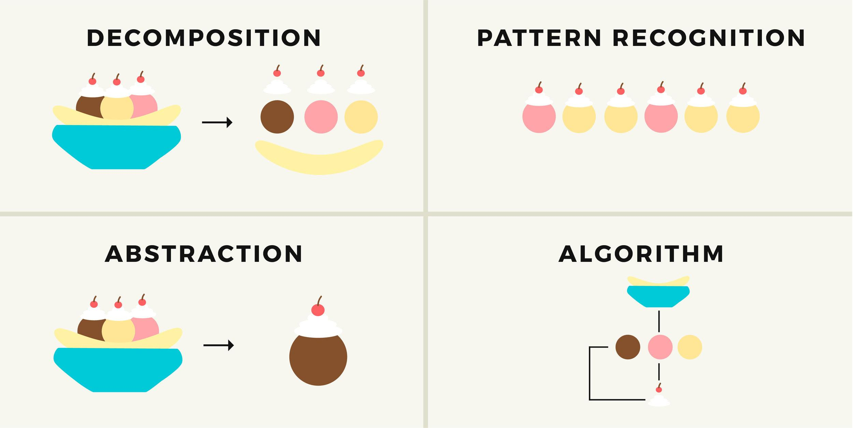
Why CT matters and how it works
Importance
Main concepts
Meaning
CT enhances adaptability, critical thinking and decision-making skills across various professions.
CT is essential for navigating technological advancements and solving real-world problems in education, daily and professional life.
CT is important for workforce development, digital literacy and lifelong learning in 21st century.
DECOMPOSITION
PATTERN RECOGNITION
CT is a cognitive framework for problem-solving or decision making using such components as decomposition, abstraction, pattern recognition, and algorithms.
Problem-solving or decision making process can be represented as computational steps and algorithms.
CT is like a hybrid thinking paradigm that must accommodate different mental models that help understand and use technology.
ABSTRACTION
ALGORITHM
“CT represents a universally applicable attitude and skillset everyone, not just computer scientists, would be eager to learn and use“ (Wing, 2006).

Slide 14

CT across industries
CT is already making an impact across many fields. The following examples show how it drives innovation and efficiency in industries from medicine to space exploration.
Medical Industry
Utilizing algorithms and data analysis enables medical professionals to diagnose diseases more accurately, interpret medical images efficiently, and detect patterns in patient data, leading to improved treatment outcomes.
Supply Chain Management
Algorithms process data to optimize shipping routes, forecast supply and demand, and enhance inventory management for maximum efficiency.
Agriculture & Farming
This is related to strategic decisions about planting, herd management, crop rotation, irrigation, pest and disease of the plants control and more.
A data-driven business strategy uses pattern recognition, modeling, and risk assessment to determine the most effective approaches for achieving objectives. These analytical methods and models are grounded in the principles of computational thinking.
Finance &
Business
Industry

Slide 15
CT across industries
Environmental protection
CT helps to analyze ecological data, monitor wildlife populations, and formulate strategies for conserving natural habitats.
Energy Industry
CT helps to enhance energy distribution efficiency. In the green energy sector helps to the design and development of wind, solar, natural gas, and geothermal energy systems.
Meteorology
CT enables the simulation and prediction of weather patterns by utilizing advanced algorithms that process extensive atmospheric data to generate precise forecasts.
Space
Exploration
Space agencies, for example, NASA, use CT to plan missions, calculate trajectories and analyze data obtained from satellites and probes.

Slide 16
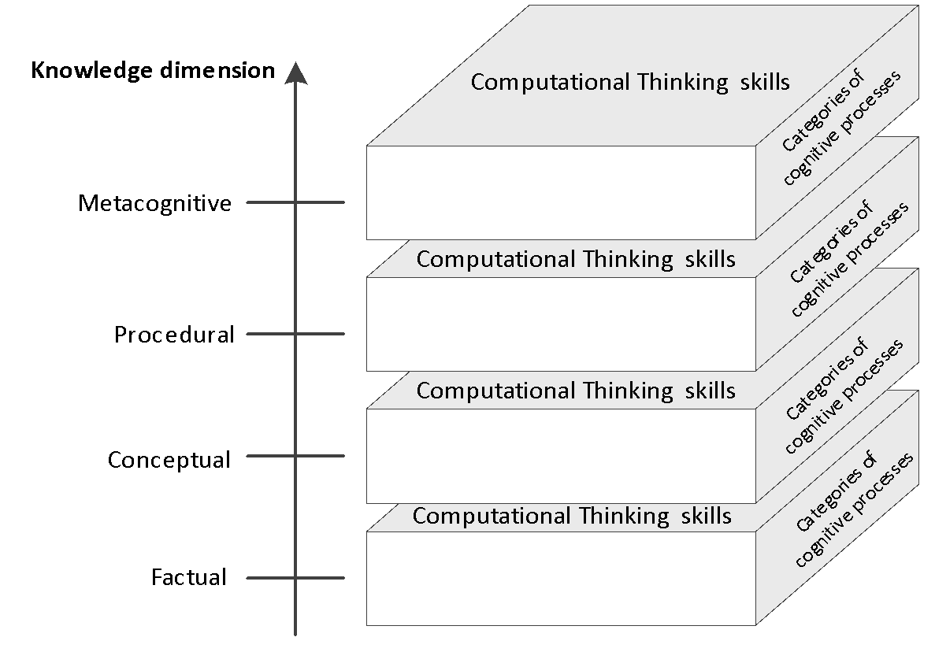
The learning framework of CT
The model shows the relation among CT skills, knowledge dimensions and categories of cognitive processes.
Computational Thinking skills
Knowledge dimension
Categories of cognitive processes
Metacognitive
Categories of cognitive processes
Computational Thinking skills
Procedural
Categories of cognitive processes
Computational Thinking skills
Conceptual
Categories of cognitive processes
Computational Thinking skills
Factual

Slide 17

Levels of thinking in learning
A lower order thinking skills An upper order thinking skills | Category | Cognitive processes
 | Remembering – retrieving relevant knowledge from long-term memory. | Recognizing Recalling
 | Understanding – determining the meaning of instructional messages, including oral, written, and graphic communication. | Interpreting, Exemplifying Classifying, Summarizing Inferring, Comparing Explaining
 | Applying – carrying out or using a procedure in a given situation. | Executing Implementing
 | Analyzing – breaking material into its constituent parts and detecting how the parts relate to one another and to an overall structure or purpose. | Differentiating Organizing Attributing
 | Evaluating – making a judgement based on criteria and standards. | Checking Critiquing
 | Creating – putting elements together to form a novel, coherent whole or make an original product. | Generating Planning Producing
Learning involves a range of thinking skills, from basic recall to complex creation.
This model shows how these skills build on each other, supporting learners as they move from understanding information to applying, analyzing, and creating with it.
These cognitive processes are important when designing meaningful and effective learning experiences.
The focus: any learning objective can be represented in two dimensions Cognitive Process and Knowledge.
Notes:
Revised Bloom’s taxonomy: the Cognitive processes’ dimension (adapted from Anderson, & Bloom, 2001).

Slide 18
UNIT 3
Challenges and opportunities in promoting CT in adult education: adopting engagement strategies
‹#›

Slide 19
This unit, "Challenges and opportunities in promoting CT in adult education: adopting engagement strategies" provides the understanding about key players in the educational process, including trainers, learners, and other relevant stakeholders.
It explores the multifaceted challenges associated with CT integration in adult education, emphasizing the necessity of a collaborative seeking to solve effectively barriers and develop sustainable solutions. By fostering cooperation among educators, learners and stakeholders, the implementation of CT can be optimized to enhance educational outcomes.
Additionally, this unit presents the learners engagement strategies in the CT education process. Following them adult trainers can integrate CT according diverse needs of adult learners, ensuring accessibility, motivation and meaningful participation in the learning process.
Despite the fact, that democratic space should be ensured, the teacher-centered approach during the trainings can be applied as well.
‹#›

Slide 20

Challenges in promoting CT for adults
The challenges of promoting CT in adult education arise from different perspectives:
Trainer-Centric Perspective: Adult trainers often face a lack of pedagogical guidelines on effectively integrating CT into their teaching. They may struggle with limited access to appropriate learning materials and insufficient skills to facilitate CT-based trainings.
Learner-Centric Perspective: Many adult learners, particularly those with lower qualifications, encounter obstacles such as a lack of motivation, internal barriers, and limited resources. Negative past educational experiences may also contribute to reluctance or anxiety toward learning new concepts. Trainers should understand these aspects.
Stakeholders role: Seeking to implement successfully CT in adults education, it is essential to engage all relevant stakeholders, who will help to ensure the inclusive educational process, provide equipment or space and will help to relate to real life problem solutions.
Notes:
“Prediction” of the context based on personal experience will not ensure learners high engagement, but can result in a biased activity.
Hsu, T. C., Chang, S. C., & Hung, Y. T. (2018). How to learn and how to teach computational thinking: Suggestions based on a review of the literature. Computers & Education, 126, 296-310.

Slide 21
Opportunities in promoting CT for adults
Despite the challenges, promoting CT in adult education opens opportunities for transformation and inclusion.
The integration of CT into adult education presents significant opportunities for low-qualified adults, enhancing their cognitive, professional, and socio-economic perspectives.
The CT contributes to social inclusion by reducing the digital divide. Adults with limited formal education often experience barriers to lifelong learning and workforce participation, yet CT training equips them with essential 21st-century skills.
CT principles fosters self-efficacy, lifelong learning habits, and active engagement in an increasingly technology-dependent society.
Notes:
“Prediction” of the context based on personal experience will not ensure learners high engagement, but can result in a biased activity.

Slide 22


Making CT work in every context
Challenge
Explanation of challenges
Opportunities
Pedagogical
Learning models that do not correspond to the learner’s needs
Difficulties with learning personalization
Difficulties with the selection of relevant teaching context
Lack of tailored resources or trainers experienced in teaching CT to low-qualified adults
Lack of knowledge of how to apply teaching strategies for low-qualified adults
Learner-centered/teachers-centered pedagogical approaches; individualized learning paths; scaffolding; investment in educator training programs; use of interactive teaching strategies (gamification, storytelling, collaborative learning, and hands-on activities)
Learning content & context
Relevant learning content; enhanced personalization; interactive simulations, graphical representations real-world case studies
In dynamic contexts to provide the newest learning content
To adopt content to every learner‘s context and needs
Content visualization and adaptation according to the context
Notes:
“Prediction” of the context based on personal experience will not ensure learners high engagement, but can result in a biased activity.

Slide 23
Making CT work in every context
Challenge
Explanation of challenges
Opportunities
Personal
The insufficient recognition of the subject's significance and practical relevance.
Lack of the learner’s motivation and engagement
Lack of experience in technology devices and knowledge, how to collect, analyze and interpret data
Resistance to new learning approaches
Integration real-world problems-solving scenarios and workplace-related tasks, adaptive learning technologies and gamified instructional; personalization, learner-centered methodologies
Cognitive
The use of high-level abstractions that hinder the understanding ability for learners with a lack of CT
The need to keep balance between the theoretical knowledge and practice may reduce the interest in particular subject
Difficulty understanding abstract concepts like algorithms or patterns.
Use of low-level abstractions; CT concepts integration in real-world scenarios; experiential learning and metacognitive strategies implementation; graphical and flowcharts representation
Notes:
“Prediction” of the context based on personal experience will not ensure learners high engagement, but can result in a biased activity.

Slide 24
Making CT work in every context
Challenge
Explanation of challenges
Opportunities
Technological
The lack of adequate tools, that provide adaptation and generalization
Lack of technical support (interactive learning should overcome obstacles related to pedagogical and cognitive problems)
Limited or no access to computers, the Internet, or digital tools
Development of adaptive educational technologies; integration of mobile learning (m-learning), offline resources, and community technology hubs
Socio-Economic / Cultural
Online and blended learning models, asynchronous course, micro-learning modules. Community-based learning centers can serve as accessible educational spaces
Competing responsibilities (jobs or family affairs) may limit time for learning.
Limited recourses (time, financial, logistics, especially if learners live the periphery).
Notes:
“Prediction” of the context based on personal experience will not ensure learners high engagement, but can result in a biased activity.

Slide 25
Strategies for CT promotion: learners engagement
To engage learners
The engagement of learners could be higher when they may play the role of mediator, leader, or team member, but everyone should participate when practicing (students, researchers, and teachers).
Learners (adults) have many life experiences to share too, therefore they can share these experiences.
The different teaching methods should be engaging: arranged in a circle, divided into teams, or other ways that favor direct communication, contact, and collaboration with each other. Activities should be presented in an inviting and attractive way to raise learners’ interest.
Notes:
Román-González, M., Pérez-González, J. C., & Jiménez-Fernández, C. (2017). Which cognitive abilities underlie computational thinking? Criterion validity of the Computational Thinking Test. Computers in human behavior, 72, 678-691.
Wing, J. M. (2008). Computational thinking and thinking about computing. Philosophical Transactions of the Royal Society A: Mathematical, Physical and Engineering Sciences, 366(1881), 3717-3725.
1 stage. Important issues to identify are students’ expectations, needs, knowledge, contents they are studying in the regular class, technologies they know or have access to, and the ones they wouldlike to learn more about. Different techniques or strategies can be put into practice to raise this information in a positive, natural, and funny way (e.g., games and storytelling). The key point is to engage people in meaningful and positive experiences with technology usage, 1317Ortiz, J. S. B., Pereira, R. RBIE v.29– 2021 promoting well-being and a feeling that we are all learning together.
2 stage. Each activity must address relevant and useful issues students want to learn, and must explore possibilities with devices they may have access to, naturally exploring CT concepts and skills with them. New activities can be elaborated, or existing ones can be adapted, as long as they incorporate relevant aspects of students’ context and follow the principles for practices with YAE students (see Section 4.1). Activities must be as universal as possible to attend the diversity of students. Defining activities to be conducted, outcomes to be evaluated, and elaborating the necessary materials to their conduction are also part of this step.
3 stage. This step also encompasses socialization and evaluation, which mayoccur in different ways according to the goal of each initiative (e.g., students’ progress, what they have learned with the activity, their perception of technological devices usage, etc.).

Slide 26
Strategies for CT promotion: learners engagement
To create a sense of need
When the activities are as close as possible to the learners’ socio-cultural context, it will make students sense that the knowledge they are creating can be applied and related to their needs, interests, desires, curiosities, difficulties, etc.
To create a sense of usefulness
When training content and practical tasks involve useful things for learners, they can apply them immediately and see the benefits.
Clear, well-structured, visualized, coherent training content will give them the feeling that they are progressing and learning more.
Notes:
Román-González, M., Pérez-González, J. C., & Jiménez-Fernández, C. (2017). Which cognitive abilities underlie computational thinking? Criterion validity of the Computational Thinking Test. Computers in human behavior, 72, 678-691.
Wing, J. M. (2008). Computational thinking and thinking about computing. Philosophical Transactions of the Royal Society A: Mathematical, Physical and Engineering Sciences, 366(1881), 3717-3725.
1 stage. Important issues to identify are students’ expectations, needs, knowledge, contents they are studying in the regular class, technologies they know or have access to, and the ones they wouldlike to learn more about. Different techniques or strategies can be put into practice to raise this information in a positive, natural, and funny way (e.g., games and storytelling). The key point is to engage people in meaningful and positive experiences with technology usage, 1317Ortiz, J. S. B., Pereira, R. RBIE v.29– 2021 promoting well-being and a feeling that we are all learning together.
2 stage. Each activity must address relevant and useful issues students want to learn, and must explore possibilities with devices they may have access to, naturally exploring CT concepts and skills with them. New activities can be elaborated, or existing ones can be adapted, as long as they incorporate relevant aspects of students’ context and follow the principles for practices with YAE students (see Section 4.1). Activities must be as universal as possible to attend the diversity of students. Defining activities to be conducted, outcomes to be evaluated, and elaborating the necessary materials to their conduction are also part of this step.
3 stage. This step also encompasses socialization and evaluation, which mayoccur in different ways according to the goal of each initiative (e.g., students’ progress, what they have learned with the activity, their perception of technological devices usage, etc.).

Slide 27
Strategies for CT promotion: learners engagement
To personalize
The training content must be applied for all the groups of learners, especially concerning limitations or difficulties in terms of movement and vision.
For disabled people (such as deafness or blindness) some specialized resource may be necessary.
The learners may study at different speeds. Instead of speeding up learners who have not finished their activities, it's better to offer additional activities for those who have already finished, ask them to help other students, or show what they have done and learned.
Notes:
Román-González, M., Pérez-González, J. C., & Jiménez-Fernández, C. (2017). Which cognitive abilities underlie computational thinking? Criterion validity of the Computational Thinking Test. Computers in human behavior, 72, 678-691.
Wing, J. M. (2008). Computational thinking and thinking about computing. Philosophical Transactions of the Royal Society A: Mathematical, Physical and Engineering Sciences, 366(1881), 3717-3725.
1 stage. Important issues to identify are students’ expectations, needs, knowledge, contents they are studying in the regular class, technologies they know or have access to, and the ones they wouldlike to learn more about. Different techniques or strategies can be put into practice to raise this information in a positive, natural, and funny way (e.g., games and storytelling). The key point is to engage people in meaningful and positive experiences with technology usage, 1317Ortiz, J. S. B., Pereira, R. RBIE v.29– 2021 promoting well-being and a feeling that we are all learning together.
2 stage. Each activity must address relevant and useful issues students want to learn, and must explore possibilities with devices they may have access to, naturally exploring CT concepts and skills with them. New activities can be elaborated, or existing ones can be adapted, as long as they incorporate relevant aspects of students’ context and follow the principles for practices with YAE students (see Section 4.1). Activities must be as universal as possible to attend the diversity of students. Defining activities to be conducted, outcomes to be evaluated, and elaborating the necessary materials to their conduction are also part of this step.
3 stage. This step also encompasses socialization and evaluation, which mayoccur in different ways according to the goal of each initiative (e.g., students’ progress, what they have learned with the activity, their perception of technological devices usage, etc.).

Slide 28
Strategies for CT promotion: learners engagement
To apply trans-disciplinary approach
Activities must involve a combination of different contents, prioritizing the work in thematic problem situations instead of specific contents.
To create a positive experience
When the experience is joyful, positive, and engaging for adults who apply CT in practices, this will have a positive impact on digital culture creation.
The process creates mental models that help learners develop familiarity with technological devices, reducing rejection and fear of exploring new technologies.
Notes:
Román-González, M., Pérez-González, J. C., & Jiménez-Fernández, C. (2017). Which cognitive abilities underlie computational thinking? Criterion validity of the Computational Thinking Test. Computers in human behavior, 72, 678-691.
Wing, J. M. (2008). Computational thinking and thinking about computing. Philosophical Transactions of the Royal Society A: Mathematical, Physical and Engineering Sciences, 366(1881), 3717-3725.
1 stage. Important issues to identify are students’ expectations, needs, knowledge, contents they are studying in the regular class, technologies they know or have access to, and the ones they wouldlike to learn more about. Different techniques or strategies can be put into practice to raise this information in a positive, natural, and funny way (e.g., games and storytelling). The key point is to engage people in meaningful and positive experiences with technology usage, 1317Ortiz, J. S. B., Pereira, R. RBIE v.29– 2021 promoting well-being and a feeling that we are all learning together.
2 stage. Each activity must address relevant and useful issues students want to learn, and must explore possibilities with devices they may have access to, naturally exploring CT concepts and skills with them. New activities can be elaborated, or existing ones can be adapted, as long as they incorporate relevant aspects of students’ context and follow the principles for practices with YAE students (see Section 4.1). Activities must be as universal as possible to attend the diversity of students. Defining activities to be conducted, outcomes to be evaluated, and elaborating the necessary materials to their conduction are also part of this step.
3 stage. This step also encompasses socialization and evaluation, which mayoccur in different ways according to the goal of each initiative (e.g., students’ progress, what they have learned with the activity, their perception of technological devices usage, etc.).

Slide 29
Strategies for CT promotion: learners engagement
OER availability and interactivity
The part of the digital culture to ensure the availability of the OER, when the adults can study an inappropriate times using blended learning models, asynchronous courses, and micro-learning modules
It shouldn't be an impediment to participate if the learner misses any activity/training. Even when activities are linked to the previous ones, a new learner should have the opportunity to continue their studies.
The interactive tools integration may help to see the progress.
But at the same time, there should be opportunities to study offline.
Notes:
Román-González, M., Pérez-González, J. C., & Jiménez-Fernández, C. (2017). Which cognitive abilities underlie computational thinking? Criterion validity of the Computational Thinking Test. Computers in human behavior, 72, 678-691.
Wing, J. M. (2008). Computational thinking and thinking about computing. Philosophical Transactions of the Royal Society A: Mathematical, Physical and Engineering Sciences, 366(1881), 3717-3725.
1 stage. Important issues to identify are students’ expectations, needs, knowledge, contents they are studying in the regular class, technologies they know or have access to, and the ones they wouldlike to learn more about. Different techniques or strategies can be put into practice to raise this information in a positive, natural, and funny way (e.g., games and storytelling). The key point is to engage people in meaningful and positive experiences with technology usage, 1317Ortiz, J. S. B., Pereira, R. RBIE v.29– 2021 promoting well-being and a feeling that we are all learning together.
2 stage. Each activity must address relevant and useful issues students want to learn, and must explore possibilities with devices they may have access to, naturally exploring CT concepts and skills with them. New activities can be elaborated, or existing ones can be adapted, as long as they incorporate relevant aspects of students’ context and follow the principles for practices with YAE students (see Section 4.1). Activities must be as universal as possible to attend the diversity of students. Defining activities to be conducted, outcomes to be evaluated, and elaborating the necessary materials to their conduction are also part of this step.
3 stage. This step also encompasses socialization and evaluation, which mayoccur in different ways according to the goal of each initiative (e.g., students’ progress, what they have learned with the activity, their perception of technological devices usage, etc.).

Slide 30
The Socially Aware Design model
The Socially Aware Design model main idea: before developing any solution, it is essential at first to understand the problem, engaging both users and stakeholders; the problem examination from multiple perspectives ensures a more comprehensive understanding of its context.
Model focuses on understanding the problem before anything else;
The understanding goes beyond just technical aspects of the problem and covers informal aspects such as culture and values and formal such as procedures and rules of the problem and context of use;
This study is carried out with the involvement of users and stakeholders who are or will be affected by the problem or its solution.
SOCIAL AWARE MODEL
1. TO KNOW
2. To CREATE
2. TO IMPLEMENT
To know learners and understand what's important to them, what technologies they use
To implement activities following the set of principles
To create abilities related to the adults interests
Notes:
(Baranauskas, 2014, Ortiz & Pereira, 2021)

Slide 31
The Socially Aware Design model
Socially Aware Design model application in adults education.
Democratic space. Everyone can express opinions, curiosity, and needs, emphasizing the subjects that are important to the participants.
Participation practices. All group members (learners) participate, therefore study object should represents all the participants’ preferences and context. The motivation, engagement, empowerment and enrichment the learning experience are important.
Priorities. First focus on learners the interests, needs, curiosities, doubts, or everyday problems that could be approached with the available technology. Then, activities to can be carried out to solve the problems, evaluating the abilities and experiences students already have.
Democratic Space
Interests
Needs, Curiosities, Doubts
Learner
Learner
Learner
Notes:
(Baranauskas, 2014, Ortiz & Pereira, 2021)

Slide 32


Are you following along? Try this quick question to reinforce what you’ve learned
What are the main challenges in implementing CT in adult education?
A) Pedagogical, Personal, Cognitive, Technological
B) Socio-economic/cultural
C) Learning content and context
D) All of them
‹#›
Notes:
Answers are:
1-a
2-b
3-c
4-a
5-b

Slide 33
UNIT 4
The impact and potential of CT on low-qualified adults
‹#›

Slide 34
In this unit, "The impact and potential of CT on low-qualified adults", we examine the necessity of CT knowledge.
The integration of CT competencies among low-qualified adults has the potential to enhance employability prospects and facilitate lifelong learning opportunities. Among the TOP 10 critical skills identified for the contemporary workforce are problem-solving, creativity, and critical thinking, where CT is frequently associated with computational critical literacy, as well as technological proficiency and adaptability.
The close relationship among computational thinking and AI thing is presented as well.
‹#›

Slide 35
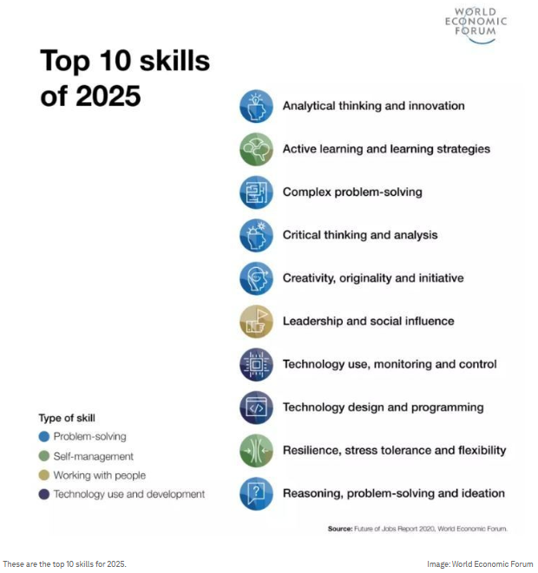
How can CT support low-qualified adults in the job market?
In 2021, the World Economic Forum identified the TOP 10 skills projected to be essential by 2025:
Problem-solving
Creativity
Critical thinking
These skills are linked to computational critical literacy and technological proficiency. CT has the potential to enhance several of these key competencies.
Within the CT education process, it is crucial to foster an inclusive and democratic learning environment where all learners can participate equally. Such an environment can enhance learners’ abilities to work with other people.
Furthermore, self-management is a critical skill for adults, enabling them to balance work and continuous professional development effectively.
Additionally, developing soft skills can be particularly beneficial for low-qualified adults, enhancing their employability in the labor market.
Top 10 skills of 2025
Analytical thinking and innovation
Active learning and learning strategies
Complex problem-solving
Critical thinking and analysis
Creativity, originality and initiative
Leadership and social influence
Technology use, monitoring and control
Type of skill
Technology design and programming
Problem-solving
Resilience, stress tolerance and flexibility
Self-management
Working with people
Technology use and development
Reasoning, problem-solving and ideation
Source: Future of Jobs Report 2020. World Economic Forum
Notes:
https://www.weforum.org/stories/2020/10/top-10-work-skills-of-tomorrow-how-long-it-takes-to-learn-them/
Román-González, M., Pérez-González, J. C., & Jiménez-Fernández, C. (2017). Which cognitive abilities underlie computational thinking? Criterion validity of the Computational Thinking Test. Computers in human behavior, 72, 678-691.
Wing, J. M. (2008). Computational thinking and thinking about computing. Philosophical Transactions of the Royal Society A: Mathematical, Physical and Engineering Sciences, 366(1881), 3717-3725.
https://www.weforum.org/stories/2020/10/top-10-work-skills-of-tomorrow-how-long-it-takes-to-learn-them/
Experences which are obtained from using CT has potentional to foster dgital culture. Ortez
Román-González, M., Pérez-González, J. C., & Jiménez-Fernández, C. (2017). Which cognitive abilities underlie computational thinking? Criterion validity of the Computational Thinking Test. Computers in human behavior, 72, 678-691.
Wing, J. M. (2008). Computational thinking and thinking about computing. Philosophical Transactions of the Royal Society A: Mathematical, Physical and Engineering Sciences, 366(1881), 3717-3725.
1 stage. Important issues to identify are students’ expectations, needs, knowledge, contents they are studying in the regular class, technologies they know or have access to, and the ones they wouldlike to learn more about. Different techniques or strategies can be put into practice to raise this information in a positive, natural, and funny way (e.g., games and storytelling). The key point is to engage people in meaningful and positive experiences with technology usage, 1317Ortiz, J. S. B., Pereira, R. RBIE v.29– 2021 promoting well-being and a feeling that we are all learning together.
2 stage. Each activity must address relevant and useful issues students want to learn, and must explore possibilities with devices they may have access to, naturally exploring CT concepts and skills with them. New activities can be elaborated, or existing ones can be adapted, as long as they incorporate relevant aspects of students’ context and follow the principles for practices with YAE students (see Section 4.1). Activities must be as universal as possible to attend the diversity of students. Defining activities to be conducted, outcomes to be evaluated, and elaborating the necessary materials to their conduction are also part of this step.
3 stage. This step also encompasses socialization and evaluation, which mayoccur in different ways according to the goal of each initiative (e.g., students’ progress, what they have learned with the activity, their perception of technological devices usage, etc.).

Slide 36
Unlocking Potential with CT
CT can have a significant impact by strengthening problem-solving abilities, logical reasoning, and decision-making skills among low-qualified adult learners across professional, educational, and everyday contexts.
The acquisition of these competencies can contribute to improved employability and expanded lifelong learning opportunities.
CT plays a crucial role in promoting digital inclusion among low-qualified adults by equipping them with essential skills for navigating the digital landscape.
Individuals with a strong understanding of CT principles demonstrate greater proficiency in technology use and exhibit higher levels of digital and artificial intelligence (AI) literacy.
Notes:
Román-González, M., Pérez-González, J. C., & Jiménez-Fernández, C. (2017). Which cognitive abilities underlie computational thinking? Criterion validity of the Computational Thinking Test. Computers in human behavior, 72, 678-691.
Wing, J. M. (2008). Computational thinking and thinking about computing. Philosophical Transactions of the Royal Society A: Mathematical, Physical and Engineering Sciences, 366(1881), 3717-3725.
Experences which are obtained from using CT has potentional to foster dgital culture. Ortez
Román-González, M., Pérez-González, J. C., & Jiménez-Fernández, C. (2017). Which cognitive abilities underlie computational thinking? Criterion validity of the Computational Thinking Test. Computers in human behavior, 72, 678-691.
Wing, J. M. (2008). Computational thinking and thinking about computing. Philosophical Transactions of the Royal Society A: Mathematical, Physical and Engineering Sciences, 366(1881), 3717-3725.
1 stage. Important issues to identify are students’ expectations, needs, knowledge, contents they are studying in the regular class, technologies they know or have access to, and the ones they wouldlike to learn more about. Different techniques or strategies can be put into practice to raise this information in a positive, natural, and funny way (e.g., games and storytelling). The key point is to engage people in meaningful and positive experiences with technology usage, 1317Ortiz, J. S. B., Pereira, R. RBIE v.29– 2021 promoting well-being and a feeling that we are all learning together.
2 stage. Each activity must address relevant and useful issues students want to learn, and must explore possibilities with devices they may have access to, naturally exploring CT concepts and skills with them. New activities can be elaborated, or existing ones can be adapted, as long as they incorporate relevant aspects of students’ context and follow the principles for practices with YAE students (see Section 4.1). Activities must be as universal as possible to attend the diversity of students. Defining activities to be conducted, outcomes to be evaluated, and elaborating the necessary materials to their conduction are also part of this step.
3 stage. This step also encompasses socialization and evaluation, which mayoccur in different ways according to the goal of each initiative (e.g., students’ progress, what they have learned with the activity, their perception of technological devices usage, etc.).

Slide 37
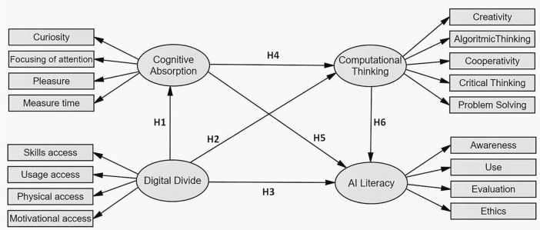
CT in the age of AI
CT elements such as decomposition, abstraction, pattern recognition, and algorithms are directly related to Artificial Intelligence (AI) thinking.
Adults who understand the CT main principles can more easily adopt technologies and better apply AI thinking principles.
Movement
CT
AI thinking
Overlap
AI thinking goes beyond CT foundations and incorporates more advanced cognitive and computational processes such as: Leveraging knowledge bases and case-based reasoning for problem-solving; Capturing and reasoning about commonsense knowledge; Enabling the processing of semantics and contextual information; Effectively handling unstructured data, among other complex tasks.
These capabilities position AI Thinking as a more holistic and adaptive framework for addressing intricate, real-world challenges.
Creativity
Curiosity
Algorithmic Thinking
Focusing of attention
Cognitive
Absorption
CT
Cooperativity
Pleasure
Critical thinking
Measure time
Problem solving
Skills access
Awareness
Usage access
Digital Divide
AI Literacy
Use
Physical access
Evaluation
Motivational access
Ethics
Source: Celik, 2023
Notes:
Wing, J. M. (2006). Computational thinking. Communications of the ACM, 49(3), 33-35.
Zeng, D. (2013). From Computational Thinking to AI Thinking [A letter from the editor]. IEEE Intelligent Systems, 28(06), 2-4.

Slide 38
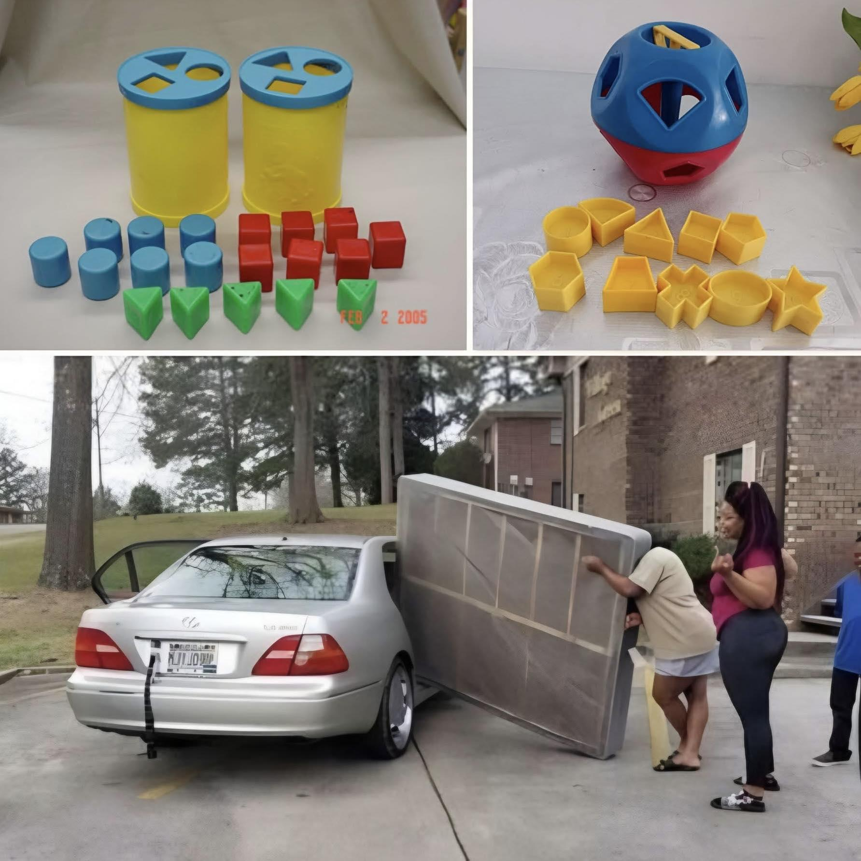

CT application in everyday scenarios
  Budget Management (decomposition): Breaking down expenses into categories, identifying spending patterns, and creating a savings algorithm.
  Household projects (decomposition): Breaking large household projects, such as moving or renovations, into manageable tasks.
  YouTube usage (algorithms): Develop a step-by-step process for conducting a voice-command search on YouTube.
Identify where do you apply CT in your daily life:
decomposition
abstraction
pattern recognition
algorithms
Present these examples to your colleagues.

Slide 39

CT application in workplace
  Customer Service: Learners can apply logical thinking to develop decision trees for improving customer service by suing patterns.
  Management: Using algorithms to forecast supply needs and minimize waste.
CT application in education
Mathematics: To solve percentage calculations (e.g., calculating discounts) can use decomposition to separate the problem into steps: identifying the original price, determining the percentage, and subtracting the discount.
Writing: Writing an essay can help to understand common structures (e.g., introduction, thesis statement, supporting arguments, and conclusion). Abstraction can help with argumentation.
Photography (algorithm): Create and present a coherent sequence for taking photos with your smartphone.
Which CT principle can help with the essay argumentation?
  Decomposition
  abstraction
  algorithm design

Slide 40
UNIT 5
Case study and activities
‹#›

Slide 41

Case study
Researchers from the Department of Informatics at the Federal University of Paraná (Brazil) conducted a case study applying fundamental computational thinking (CT) skills to help participants develop essential mental models for understanding technology and fostering digital culture (Ortiz et al., 2023)
The study involved adults in the early stages of literacy, progressing through activities that ranged from simple, low-fidelity ATM prototype exercises to more complex tasks using a functional ATM prototype.
Generated with Firefly
A total of eight workshops focused on financial literacy and ATM usage were implemented. Initially, the workshop objectives, activities, and attendance requirements were introduced. Then, the CT skills to be acquired during each session were identified, followed by an analysis of the results from each workshop.
The evaluation methods included voting, participant feedback, structured observations, and unstructured interviews.
The results indicated that these methods were effective, as participants became increasingly self-assured and independent. As the activities progressed, they successfully applied the skills and knowledge gained from earlier exercises to complete subsequent tasks.

Slide 42
Case study
Goal and activity | CT skills | Main result
1. Identify learners interests; story telling | Algorithm | The main interests where identified
2. Present ATM concepts; Hangman game | Decomposition, data analysis, pattern recognition | Learners were engaged in reading
3. Make withdrawals in a low-fidelity ATM prototype; Bingo-type game | Decomposition, data analysis, pattern recognition, simulation and abstraction | The withdrawals experiences helped better to understand processes
4. Describe the steps involved in withdrawing money from an ATM; a low-fidelity ATM prototype | Decomposition, data analysis, pattern recognition, simulation and abstraction, algorithm | The understanding how to describe the process step-by-step of withdrawing from an ATM in the following steps
5. Interpreting, ordering, executing a cash withdrawal algorithm; a pictorial algorithm, a high-fidelity ATM prototype | Decomposition, data analysis, pattern recognition, simulation and abstraction, algorithm | Execution the withdrawal process at the functional terminal
6. Practicing to pay the bills, checking cash; Algorithm to check cash change | Decomposition, data analysis, pattern recognition, simulation and abstraction, algorithm | Practiced the task, they usually have difficulties with
7. Practicing to use calculator | Decomposition, data analysis, pattern recognition, simulation and abstraction, algorithm | The identification of smartphones functions
8. Remember previous discussions | Abstraction | Qualitative feedback

Slide 43
Activity 1: Quiz
1. Why is computational thinking considered a transversal skill?
Because it is only useful in science and technology
Because it can be applied across different life contexts, professions, and learning areas
Because it is mainly used in programming classes
2. What is one main challenge adult trainers face when promoting CT?
Too many CT tools to choose from
Learners being too tech-savvy
Lack of pedagogical guidelines and limited access to CT materials
3. Which of the following increases learner engagement in CT-based training?
Encouraging learners to take active roles like mediator or team member
Only using lecture-based methods
Avoiding collaboration to save time
4. What is the first step in the Socially Aware Design model for CT integration?
To test learners with complex CT challenges
To understand the learners’ context, needs, and technologies they use
To start teaching technical procedures immediately
5. Which key skills linked to CT were highlighted by the World Economic Forum?
Cooking, memorization, and time management
Problem-solving, creativity, and critical thinking
Typing speed, spelling accuracy, and note-taking
‹#›
Notes:
Answers are:
1-b
2-c
3-a
4-b
5-b

Slide 44
Activity 2: Practical exercise
Resources
Daily Life
Task. Imagine it's now nightfall and our friends stuck in the forest. Help them survive the night.
Result. The flow chart will help visually (1) break down the problem (decomposition) and (2) algorithm design will help to plan the steps for the problem solving
For this task implementation you need
Sticky notes
Sheet of paper
Writing means (pencils, pens, markers)
1) The group of 4 members should solve, the problem, how to survive the night.
The goal should be at the top, and high-level considerations should be the first step in the phases that follow. After that, these high-level factors can be braked down into smaller steps.
Goal:
to survive at nigh in the forest
Identify location
Find water
Warm up
Map
Source
Fire

Slide 45
Activity 2: Practical exercise
2. Apply the problem solving algorithm design principles.
The group of 4 members should visualize a step-by-step process, how to solve the problem.
Do you have connection?
Can you identify your location?
What is next?
Look at your phone
No
Yes
Notes:
https://librarycarpentry.github.io/lc-computational-thinking/intro.html

Slide 46
SUMMARY
Computational Thinking offers a powerful set of skills and mindsets for navigating today’s digital and AI-driven society. In this module, we explored how CT goes beyond technical disciplines and plays a key role in adult education, especially for low-qualified learners.
We looked at the challenges many adults face in accessing upskilling opportunities across Europe and how CT can help bridge those gaps by promoting adaptability, critical thinking and lifelong learning.
Through real-world applications and examples, we examined how CT is used across industries and everyday life, and how its integration can boost employability, digital inclusion and participation in the evolving job market.
This module also emphasized the importance of designing inclusive training strategies that equip adult learners with the tools to engage meaningfully with digital tools and concepts, including artificial intelligence, in both personal and professional contexts.

Slide 47

CALL TO ACTION
Reflect on what you’ve learned
What is the meaning of computational thinking in 21st century?
What are challenges, opportunities and strategies for CT promotion?
What is the impact and potential of CT on low-qualified adults?

Slide 48
GLOSSARY
Computational Thinking or CT: Solving problems like a computer would, step-by-step.
Decomposition: Breaking a big problem into smaller parts.
Abstraction: Focusing only on the important details.
Pattern Recognition: Spotting trends or things that repeat.
Algorithm: A set of instructions to complete a task.
Iteration: Repeating a process to improve it.
Unplugged Activities: Learning CT without screens using games, puzzles, etc.
Debugging: Finding and fixing errors in a process.
Soft Skills: Non-technical abilities that help people work well with others and adapt to challenges.
Gamification: Using game elements (like points or challenges) in learning.
Digital Literacy: Knowing how to use digital tools safely and effectively.
Inclusion: Making learning accessible to everyone, no matter their background.
Scaffolding: Supporting learners step-by-step so they can gradually do more on their own.

Slide 49
REFERENCES
Anderson, L. W., & Bloom, B. S. (2001). A taxonomy for learning, teaching, and assessing: A revision of Bloom’s taxonomy of educational objectives. Longman.
Atmatzidou, S., & Demetriadis, S. (2016). Advancing students’ computational thinking skills through educational robotics: A study on age and gender relevant differences. Robotics and Autonomous Systems, 75, 661-670.
Baranauskas, M. C. C. (2014). Social awareness in HCI. interactions, 21(4), 66-69.
Burbaitė, R., Drąsutė, V., & Štuikys, V. (2018, April). Integration of computational thinking skills in STEM-driven computer science education. In 2018 IEEE Global Engineering Education Conference (EDUCON) (pp. 1824-1832). IEEE.
Celik, I. (2023). Exploring the determinants of artificial intelligence (Ai) literacy: Digital divide, computational thinking, cognitive absorption. Telematics and Informatics, 83, 102026.
Cummins, K. (2016). Teaching Digital Technologies & STEM: Computational Thinking, coding and robotics in the classroom. Retrieved from Amazon. com.
Ortiz, J. S., & Pereira, R. (2021). Computational Thinking for Youth and Adults Education: model, principles, activities and lessons learned. Revista Brasileira de Informática na Educação, 29, 1312-1336.
Román-González, M., Pérez-González, J. C., & Jiménez-Fernández, C. (2017). Which cognitive abilities underlie computational thinking? Criterion validity of the Computational Thinking Test. Computers in human behavior, 72, 678-691.
These are the top 10 job skills of tomorrow – and how long it takes to learn them. Oct 21, 2020 Available online https://www.weforum.org/stories/2020/10/top-10-work-skills-of-tomorrow-how-long-it-takes-to-learn-them/
Zeng, D. (2013). From Computational Thinking to AI Thinking [A letter from the editor]. IEEE Intelligent Systems, 28(06), 2-4.
Wing, J. M. (2006). Computational thinking. Communications of the ACM, 49(3), 33-35.
Wing, J. M. (2008). Computational thinking and thinking about computing. Philosophical Transactions of the Royal Society A: Mathematical, Physical and Engineering Sciences, 366(1881), 3717-3725.
Notes:
Burbaitė, R., Drąsutė, V., & Štuikys, V. (2018, April). Integration of computational thinking skills in STEM-driven computer science education. In 2018 IEEE Global Engineering Education Conference (EDUCON) (pp. 1824-1832). IEEE.
Ortiz, J. S., & Pereira, R. (2021). Computational Thinking for Youth and Adults Education: model, principles, activities and lessons learned. Revista Brasileira de Informática na Educação, 29, 1312-1336.

