Slide 1




MODULE 1
How do computers think?. Understanding Computational Thinking
The COMPutational Seniors project is co-funded by the European Union. The views and opinions expressed in this document commit only to the author(s) and do not necessarily reflect those of the European Union or the Spanish Service for the Internationalization of Education (SEPIE). Neither the European Union nor the SEPIE National Agency can be held responsible for them.

Slide 2






Welcome to the COMPutational Seniors course
This course is designed for adult trainers who want to bring computational thinking (CT) into their practice — even if they have little or no background in tech.
Computational thinking isn’t just about programming — it’s a way of solving problems, thinking logically, and adapting to a digital world. And adults, especially those from vulnerable or low-skilled groups, can benefit greatly from it.
In this course, you will:
This course is designed for adult trainers who want to bring Computational Thinking (referred to as CT as well throughout the modules), into their practice, even if they have little or no background in tech.
Computational Thinking isn’t just about programming, it’s a way of solving problems, thinking logically and adapting to a digital world. Adults, especially those from vulnerable or low-skilled groups, can benefit greatly from it.
In this course, you will:
01
02
Understand what computational thinking is and why it matters in adult education.
Learn the core CT concepts: decomposition, abstraction, pattern recognition and algorithms
03
04
Explore didactic strategies to make these concepts accessible, engaging and inclusive.
Use CT to develop soft skills like problem-solving and collaboration in your learners.
05
06
Apply CT across different contexts, from everyday tasks to lifelong learning.
Create and adapt your own CT-based activities using course examples.
Ready? Let’s discover how Computational Thinking can open new doors for adult education.

Slide 3


WELCOME TO MODULE 1
In this module, you will discover how computers think and the principles that make up computational thinking.
We will explore the conceptual foundations of this methodology, focusing on key elements such as decomposition, pattern recognition, abstraction, and algorithm design, and how these processes enable structured and efficient problem-solving. We will look at how this approach has been adopted in compulsory education across many European countries and analyze its potential application in adult education.
Through practical examples, you will learn to identify these principles in everyday life and apply them in educational contexts tailored to adult learners.
Use this module to help your students develop a mindset
they can apply beyond the classroom

Slide 4
STRUCTURE OF THE MODULE
Unit 1. What is Computational Thinking?
Unit 4. Core principles of Computational Thinking
Definition and core principles of CT
Origins and evolution of the concept
Key characteristics
Decomposition
Pattern Recognition
Abstraction
Algorithms
Unit 2. The value of Computational Thinking in adult learning
Unit 5. Computational Thinking in the European educational structure
Why is Computational Thinking important?
Everyday examples of CT in action
Benefits for adult learners
Current landscape of CT in Europe
How different countries are integrating CT
Unit 3. Computer thinking, human thinking and Computational Thinking
Unit 6. Case studies and activities
Real-world examples of CT
Interactive exercises to explore and apply decomposition, patterns, abstraction, and algorithms
How computers process information
How humans think
Comparing both types of thinking
Programming vs. Computational Thinking: core differences

Slide 5
Describe what computational thinking is and how it differs from human thought processes.
Determine how the four key principles of computational thinking (decomposition, pattern recognition, abstraction, and algorithms) can be used to solve problems.
At the end of the course, the learner will be able to…
Learning outcomes
Identify examples of decomposition, pattern recognition and abstraction and how these lead to creating algorithms.
Acknowledge that computers and humans approach problem-solving differently
Demonstrate computational thinking through decomposition, pattern recognition, abstraction, and algorithm development.

Slide 6

MODULE AIM and OBJECTIVES
AIM: To introduce the concept of Computational Thinking, explain its core components and highlight its relevance in everyday life and lifelong learning, particularly for low-qualified adults.
OBJECTIVES:
Define what CT is and why it matters in today’s world.
Break down the four core techniques of CT: decomposition, pattern recognition, abstraction, and algorithms.
Show how CT helps individuals solve problems more effectively and make everyday tasks easier to manage.
Set the foundation for understanding how CT can be integrated into adult education.
Notes:
c

Slide 7

UNIT 1
What is Computational Thinking?
‹#›

Slide 8

What is Computational Thinking?: Definition
Computational Thinking can be defined as a method for understanding and solving different types of problems by applying principles from computer science. It is a reasoning process that helps to analyze and resolve challenges independently of the use of computers, relying on logic, organization and step-by-step thinking.
At its core, it involves breaking down complex problems into smaller parts (decomposition), identifying patterns (pattern recognition), focusing on essential information (abstraction) and designing step-by-step strategies to reach a solution (algorithms).
This way of thinking offers a flexible framework that can be applied to everyday situations and common problem-solving scenarios. Beyond its practical value, Computational Thinking also fosters essential 21st-century skills such as critical thinking, adaptability, creativity, and collaboration.
CT is a core skill in the digital age. As technology continues to evolve rapidly, the ability
to think computationally will become even more essential for innovation and success in many industries.

Slide 9


What is Computational Thinking?: Origin
Although the concept of Computational Thinking had been mentioned earlier, it was in 2006 that computer scientist Jeannette Wing formally introduced it in an article published in Communications of the ACM. She described it as a way of solving problems and understanding human behavior using fundamental ideas from computer science.
In her 2006 definition, Wing stated:
Later, in 2011, she refined her definition:
We selected these definitions because they lay the groundwork for understanding CT as both a mindset and a problem-solving approach beyond technical skills. Two ideas from this last definition are particularly important for education:
    “Computational thinking involves solving problems, designing systems, and understanding human behavior, by drawing on the concepts fundamental to computer science. Computational thinking includes a range of mental tools that reflect the breadth of the field of computer science.”
“Computational thinking is the thought processes involved in formulating problems and their solutions so that the solutions are represented in a form that can be effectively carried out by an information-processing agent.”
      Computational Thinking is a thought process not dependent on computers or technology.
      It is a specific type of problem-solving that involves designing solutions executable by humans, machines or both.

Slide 10

What is Computational Thinking?: Origin
Wing’s definition gave us a starting point, but many educators and researchers have expanded on this idea. Let’s look at a few more definitions that add depth and nuance to our understanding of CT.
According to Barr & Stephenson:
According to ISTE (International Society for Technology in Education):
    “Computational Thinking is a problem-solving process that includes (but is not limited to) the following characteristics: logically organizing and analyzing data, representing data through abstractions, and automating solutions through algorithmic thinking.”
“CT is a set of problem-solving skills and techniques that software engineers use to write programs, but which can also be used to support problem-solving across all disciplines, including the humanities.”
Each of these definitions highlights a different strength of Computational Thinking. As a trainer,
understanding these perspectives helps you introduce CT not just as a method, but as a flexible mindset adaptable to diverse learning needs.

Slide 11
What is Computational Thinking?: Origin
Long before the term Computational Thinking was formally introduced, programming already had a place in education. In the 1980s, many students were introduced to programming through a language called Logo, developed in 1968 by Seymour Papert at MIT. Logo allowed learners to explore mathematical and scientific ideas by giving simple commands to a turtle on the screen, offering immediate, visual feedback that made abstract concepts easier to grasp.
Although Logo gradually faded from classrooms, the early 2000s brought renewed interest in educational programming with the development of tools like Scratch, Alice, Kodu, and AppInventor. These platforms, especially Scratch, made programming far more accessible thanks to their visual, block-based structure, allowing users, particularly children, to experiment with logic and creative problem-solving.
While the initial focus was on school-aged learners, the value of Computational Thinking is now extending into adult education, where it offers powerful strategies for understanding problems and making better decisions, regardless of a person’s background or profession.
Today, international efforts continue to promote the integration of Computational Thinking across
all stages of education. Increasingly, it is recognized as an important skill for lifelong learning, along with reading and writing.

Slide 12

What is Computational Thinking?: Characteristics
As we have just explored, Computational Thinking is a structured and adaptable approach to problem-solving that draws on key concepts from computer science. It is characterized by:
It is based on four core principles: decomposition, pattern recognition, abstraction and algorithms, which guide the way problems are understood and approached.
It encourages a logical and organized mindset, helping individuals break down complex challenges into simpler steps.
It supports the ability to filter information, focus on what’s essential and ignore distractions.
It promotes strategic thinking, allowing learners to plan, test and adjust actions as needed.
It is transferable across contexts, helping adults apply the same reasoning process in learning or daily life.
Now that we’ve defined Computational Thinking and explored its core characteristics, let’s now
explore its importance and how we already use it without realizing.

Slide 13


Are you following along? Try this quick question to reinforce what you’ve learned
Computational Thinking...
A) Encourages a logical and organized mindset
B) Supports the ability to filter information
C) Promotes strategic thinking
D) All of the above
‹#›
Notes:
Answers are:
1-a
2-b
3-c
4-a
5-b

Slide 14
UNIT 2
The value of CT in adult learning
‹#›

Slide 15

Why is Computational Thinking important?
Integrating Computational Thinking into your training it’s a necessary response to the world we live in. We are surrounded by technology and an overwhelming amount of information that guides the way we work and make decisions. Teaching CT means giving learners the skills to face these realities. It encourages the development of soft skills to understand and navigate the digital world as users and citizens.
CT integration into adult education It’s also about helping people acquire a mindset that prepares them to adapt to change, approach problems strategically and understand the digital world that increasingly defines our everyday lives. In this sense, CT becomes a bridge to inclusion, employability and lifelong learning for adult learners.
Despite growing awareness of its importance, bringing CT into adult learning remains a challenge. As a trainer, you have a unique opportunity to provide adult learners with a mindset that helps them adapt to a fast-paced world.

Slide 16




We use Computational Thinking every day
Computational Thinking may sound technical, but it's something we already do, often without even realizing it. Many everyday tasks involve the same logical steps: breaking things down, identifying patterns, following instructions and solving problems.
Think about these examples:
Following a recipe
Doing laundry
Planning a trip
Explain a concept to students
You break down a dish into steps (decomposition), follow instructions in order (algorithms), adjust for ingredients or time (abstraction) and recognize patterns in how recipes work.
You sort clothes by color or fabric (pattern recognition), choose a cycle depending on the load (decision-making) and follow steps in a sequence
You gather information, choose routes and schedules (algorithmic thinking), and adapt your plan based on budget or time (abstraction and problem-solving).
You simplify it into smaller parts, use examples that match their experience (pattern recognition), and present it in logical steps.
As a trainer, recognizing CT in daily activities can help you make it accessible for your learners. It’s about showing them how to use a way of thinking they already apply and helping them transfer it into new contexts like learning, work and digital environments.

Slide 17


What does CT bring to learners?
Ultimately, Computational Thinking is not simply about knowing how to program. Through this learning process, learners are equipped with a set of tools that allow them to strengthen their problem-solving abilities, design and create projects, express ideas, improve concentration and make informed decisions.
In this sense, adult learners will be able to:
Enhance their cognitive and socio-emotional skills to solve everyday problems.
Improve their creativity and imagination to explore alternative solutions to different challenges.
These skills are not only useful in the classroom but also transferable to other areas of everyday life, like employment and collaboration.
As a trainer, you have the chance to bring this mindset into your classroom as a lens to help learners approach problems.
What are some daily challenges your learners face that could benefit from a computational thinking approach?

Slide 18
UNIT 3
Computer thinking, human thinking and CT
‹#›

Slide 19

How do computers “think"?
Now that we’ve defined Computational Thinking, explored its core characteristics and importance, let’s take a closer look at how computers “think”, and how that compares to the way we, as humans, process and solve problems.
Computers don’t think or feel like we do. Instead, they solve problems by following clear, logical instructions. Their power lies in speed, precision, and their ability to repeat actions exactly the same way every time. Understanding how they work helps us better apply the principles of Computational Thinking.
Turning the power on and off
Binary code, the language of computers
Logic gates and decisions
Computers use electricity. At the most basic level, they use the presence (coded as 1) or absence of electricity (coded as 0) in a circuit to form a simple language constituted of two numbers, 0 and 1
The assemblage of 0 and 1 is called the binary code. Computers use this code to process and store data. Everything on a computer the user interacts with such as text, images or videos is broken down into 0s and 1s.
Computers use logic gates (AND, OR, NOT) to make decisions. These gates control the flow of data based on binary input, allowing the computer to execute commands efficiently and perform complex tasks through simple logical operations.
Just as computers follow logical sequences, Computational Thinking helps us solve problems using similar principles. But what about us, how do we think and process information?

Slide 20

How do humans “think"?
Human thinking is far more flexible and creative than a computer’s logic. Our brains don’t rely on binary code or step-by-step commands. Instead, we learn, feel, adapt and make decisions in ways that are influenced by emotions and experience.
The brain’s structure
Neural networks
Human cognition
The human brain contains around 80 to 100 billion neurons. These cells send signals to each other to help us think, move, feel, and remember.
Neurons build connections called neural networks. The more we use certain pathways, the stronger they become. This is how we learn and develop new habits or skills.
It’s still uncertain how the brain actually takes ideas and combines them in new ways to form newer thoughts.
Understanding how both computers and humans’ approach problem-solving helps us see the power of Computational Thinking. Now, let’s compare the two and explore how these differences can guide us in designing better learning experiences.

Slide 21

How do computers and humans think? A comparison
Understanding how computers and humans think helps us appreciate why Computational Thinking is such a powerful tool. While computers rely on logic and structure, human thinking brings flexibility and creativity. Both have strengths and combining them can lead to better problem-solving.
Computers | Humans
Follow strict, step-by-step instructions | Can adapt steps or change approach mid-process
Use binary language (0s and 1s) to process data | Use language, emotion, intuition and experience
Make decisions based on logic gates | Make decisions based on logic and feelings/context
Repeat tasks with precision | Learn from experience and change behavior
Don’t “understand” what they do | Reflect, imagine, and create new ideas
Computational Thinking bridges these two worlds: it teaches us to approach problems like a computer (clear, logical, structured) while still using the human ability to adapt, learn, and innovate.
Now that we've explored how computers and humans think differently, it's time to clarify an important distinction that
will guide us throughout the module structure: the difference between Computational Thinking and programming.

Slide 22

Programming vs. Computational Thinking:
core differences
There is often confusion between CT and programming, but it’s important to understand they are not the same. According to the International Society for Technology in Education (ISTE), both CT and programming use similar cognitive processes and aim to break down and solve problems using algorithmic thinking. However, the key difference lies in their focus.
Computational Thinking is the cognitive ability to solve problems logically and systematically. It involves analyzing a problem, identifying patterns, abstracting relevant information and designing a step-by-step solution, regardless of whether a computer is involved.
Programming, on the other hand, is the technical skill of implementing those solutions through code. It requires formal learning and familiarity with programming languages to convert ideas into executable instructions for a machine.
To clarify this distinction, the organization Programamos offers a useful definition: we can understand CT as a mental skill, while programming is a practical tool that puts that thinking into action.
Computational Thinking helps us think clearly.
Programming helps us execute those thoughts.

Slide 23
UNIT 4
Computational Thinking core principles
‹#›

Slide 24
When we face a challenge or difficulty, two things can happen: Either insecurity takes over and it becomes hard to face the problem, or our understanding of Computational Thinking helps us stay calm and think strategically to find a way through it.
Having this mindset allows us to build confidence and identify the steps we need to tackle challenges more effectively.
Computational Thinking teaches us a way of thinking, a structured approach to facing different problems. But…
What does it mean to apply Computational Thinking in practice?
We've already defined the concept, now it’s time to explore how it works.
Computational Thinking can be broken down into four core components: Decomposition, Pattern Recognition, Abstraction and Algorithms.
In this unit, we’ll explore each of these principles to understand
how they help us make sense of complex problems and build
logical and efficient solutions.

Slide 25
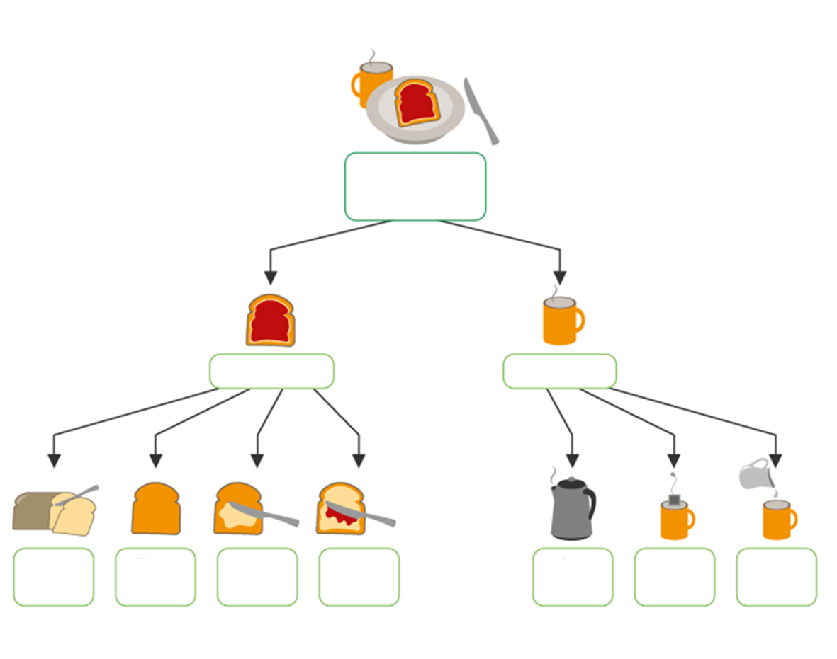
Core components:
Decomposition
How to make
Breakfast
Make toast
Make coffee
Slice bread
Toast bread
Butter toast
Add jam
Boil water
Brew tea
Add milk
Decomposing the process of making an English Breakfast

Slide 26
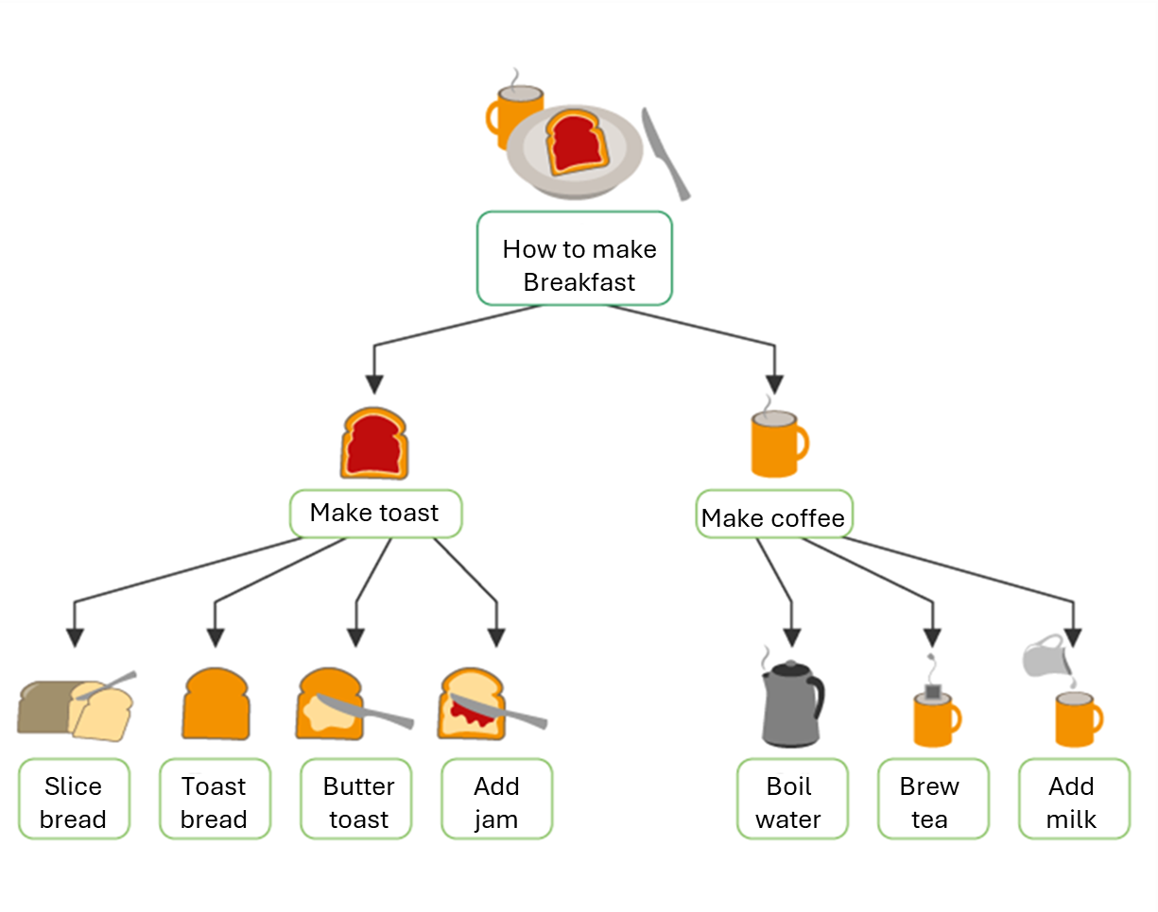
Decomposition
When we're faced with a challenge, it may often feel too complicated to solve all at once. Decomposition aims to break down that big problem into multiple smaller problems.
Decomposition is the process of breaking down a complex problem or system into smaller parts. This allows for easier analysis, solution development and overall understanding of each component before tackling the problem as a whole. It’s an essential first step in computational thinking.
In this example, "making breakfast" is divided into simpler subtasks like making toast and brewing tea. Each of those is further broken down. For example: slicing bread, toasting, boiling water, etc.
This approach serves two main purposes:
      It reduces the sense of being overwhelmed by complexity.
      It allows responsibilities to be distributed. For instance, one person makes the toast while another prepares the tea.
“Divide and conquer” is a fundamental pillar of Computational Thinking. By solving the smaller problems,
we increase the chances of reaching the overall solution more quickly and effectively.

Slide 27

Decomposition
When we decompose a problem, we simplify it to make it easier to solve, but also easier to teach, delegate and adapt. For adult learners especially, this technique helps shift focus from being overwhelmed to identifying a clear starting point.
What trainers should know:
Decomposition builds learners’ confidence. Small wins matter, achieving smaller subtasks encourages progress and motivation.
It’s a powerful way to model critical thinking out loud. Talk through how you would break down a problem.
In group settings, decomposition is perfect for collaboration as each learner or group can tackle one part and later bring the full solution together.
Trainer activity idea
Choose a daily task (For example, planning a birthday party). Ask learners to work in pairs or small groups and break it down into subtasks. Then ask:
    Which subtasks are dependent on others?
    Can some be done in parallel?
    Who would you assign each to?
Notes:
Understanding Decomposition in practice

Slide 28
Decomposition
Example in real life:
Planning a holiday trip becomes less stressful when split into parts: choosing a destination, setting a budget, booking transport, finding accommodation, creating an itinerary.
Example in business:
Imagine organizing a company training event. Decompose into:
These tasks can be handled by different team members and planned across a timeline.
What trainers can do:
Highlight real-world value: Learners often engage better when they can see how a skill transfers to their personal or professional lives.
Encourage learners to reflect: “What complex task did you face recently? How could you have broken it down?”
Visualize decomposition using mind maps, post-its or digital whiteboards.
Booking the venue
Preparing learning materials
Sending invites
Arranging catering
Collecting feedback
Use decomposition to design your own sessions. Break your lesson into intro, hands-on, group work and reflection.
Model the technique while teaching it.

Slide 29
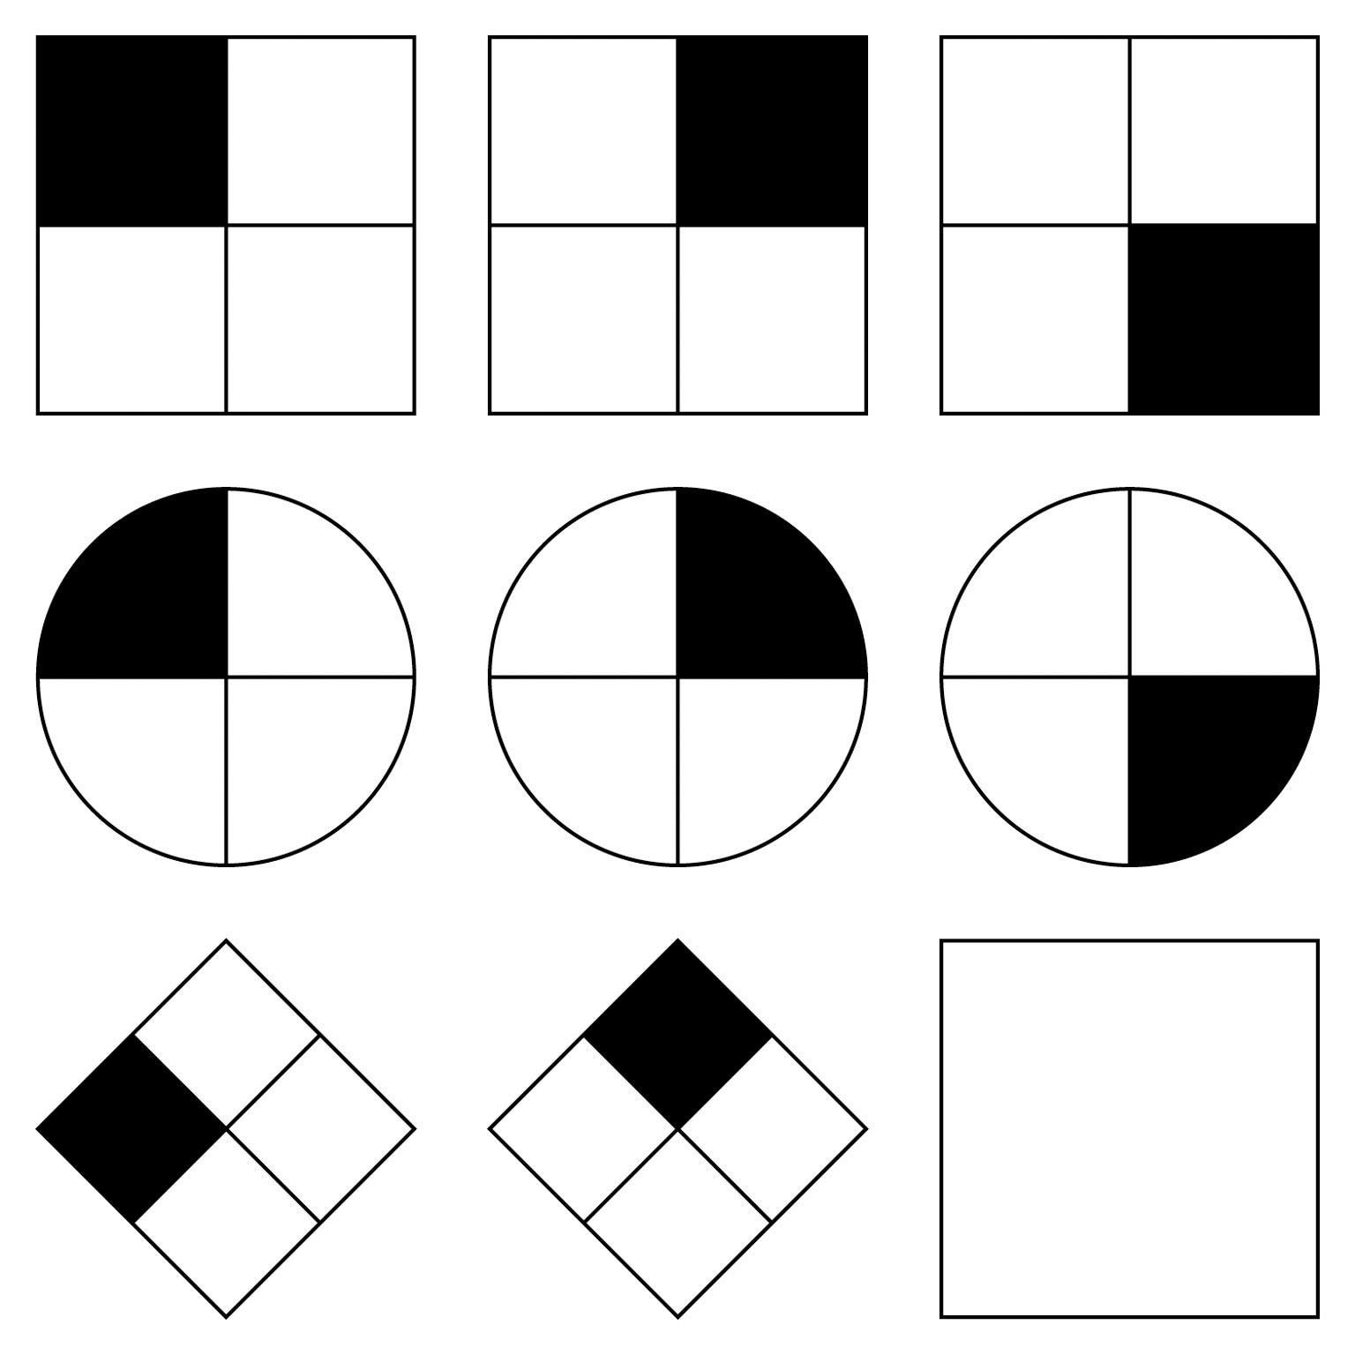
Core components:
Pattern Recognition
Patterns and shapes

Slide 30
Pattern Recognition
When we try to solve a problem, we aim to find the most effective and productive approach. This is where identifying patterns becomes valuable. Once we’ve broken down the initial problem, we may notice that certain parts repeat or resemble each other, these are what we call patterns. Sometimes, the situation may even remind us of a previous problem we’ve already solved. If we can detect these similarities, it becomes much easier to tackle the smaller parts of the problem.
Pattern recognition is the process of identifying trends, similarities, or recurring themes within problems. This makes it possible to simplify the solution process and reuse strategies. It also helps us anticipate outcomes and build efficient plans, making it a core part of Computational Thinking.
In this image, we can observe different shapes that repeat a visual sequence. By analyzing how each figure changes slightly from one to the next, we start to notice patterns. For example, the rotation or placement of the black sections.
Recognizing these visual patterns helps illustrate how our brain detects similarities, which is a key skill when solving problems using Computational Thinking.

Slide 31
Pattern Recognition
When we recognize a pattern, we reduce complexity by reusing what we already know. For adult learners, this is especially powerful as it builds on their experience. Instead of starting from scratch, learners start to say that they’ve seen this before. This ability is essential in everyday decisions and problem-solving.
What trainers should know:
Pattern recognition boosts problem-solving capabilities. Learners don’t have to reinvent the wheel as they can spot what has worked before.
It’s a great opportunity to connect new knowledge to prior experience. You can ask learners to share situations where they recognized patterns before.
Trainer activity idea
Choose a real-life task like going grocery shopping. Ask learners to think about how they usually do it and identify any repeating steps or habits. Then ask:
    Do you always check your kitchen first?
    Do you buy similar things every week?
    Can you think of a time when noticing a pattern helped you avoid a problem?

Slide 32
Pattern Recognition
Example in real life:
Detecting patterns in your daily commute, like when traffic tends to be heavier, helps you adjust departure times.
Example in data science:
Analyzing customer purchase behavior to identify common purchasing patterns, which can inform future marketing campaigns.
What trainers can do:
Use familiar examples from learners’ lives, like cleaning routines, shopping habits or cooking steps, to spark recognition.
Ask learners to spot repeated steps and compare them: “What do you always do first?” “What repeats every time?”
Emphasize that finding and reusing patterns saves time and energy.
Spotting patterns help learners solve problems faster. Encourage them to notice repeated routines and show
them how using those patterns makes work easier and more efficient.

Slide 33
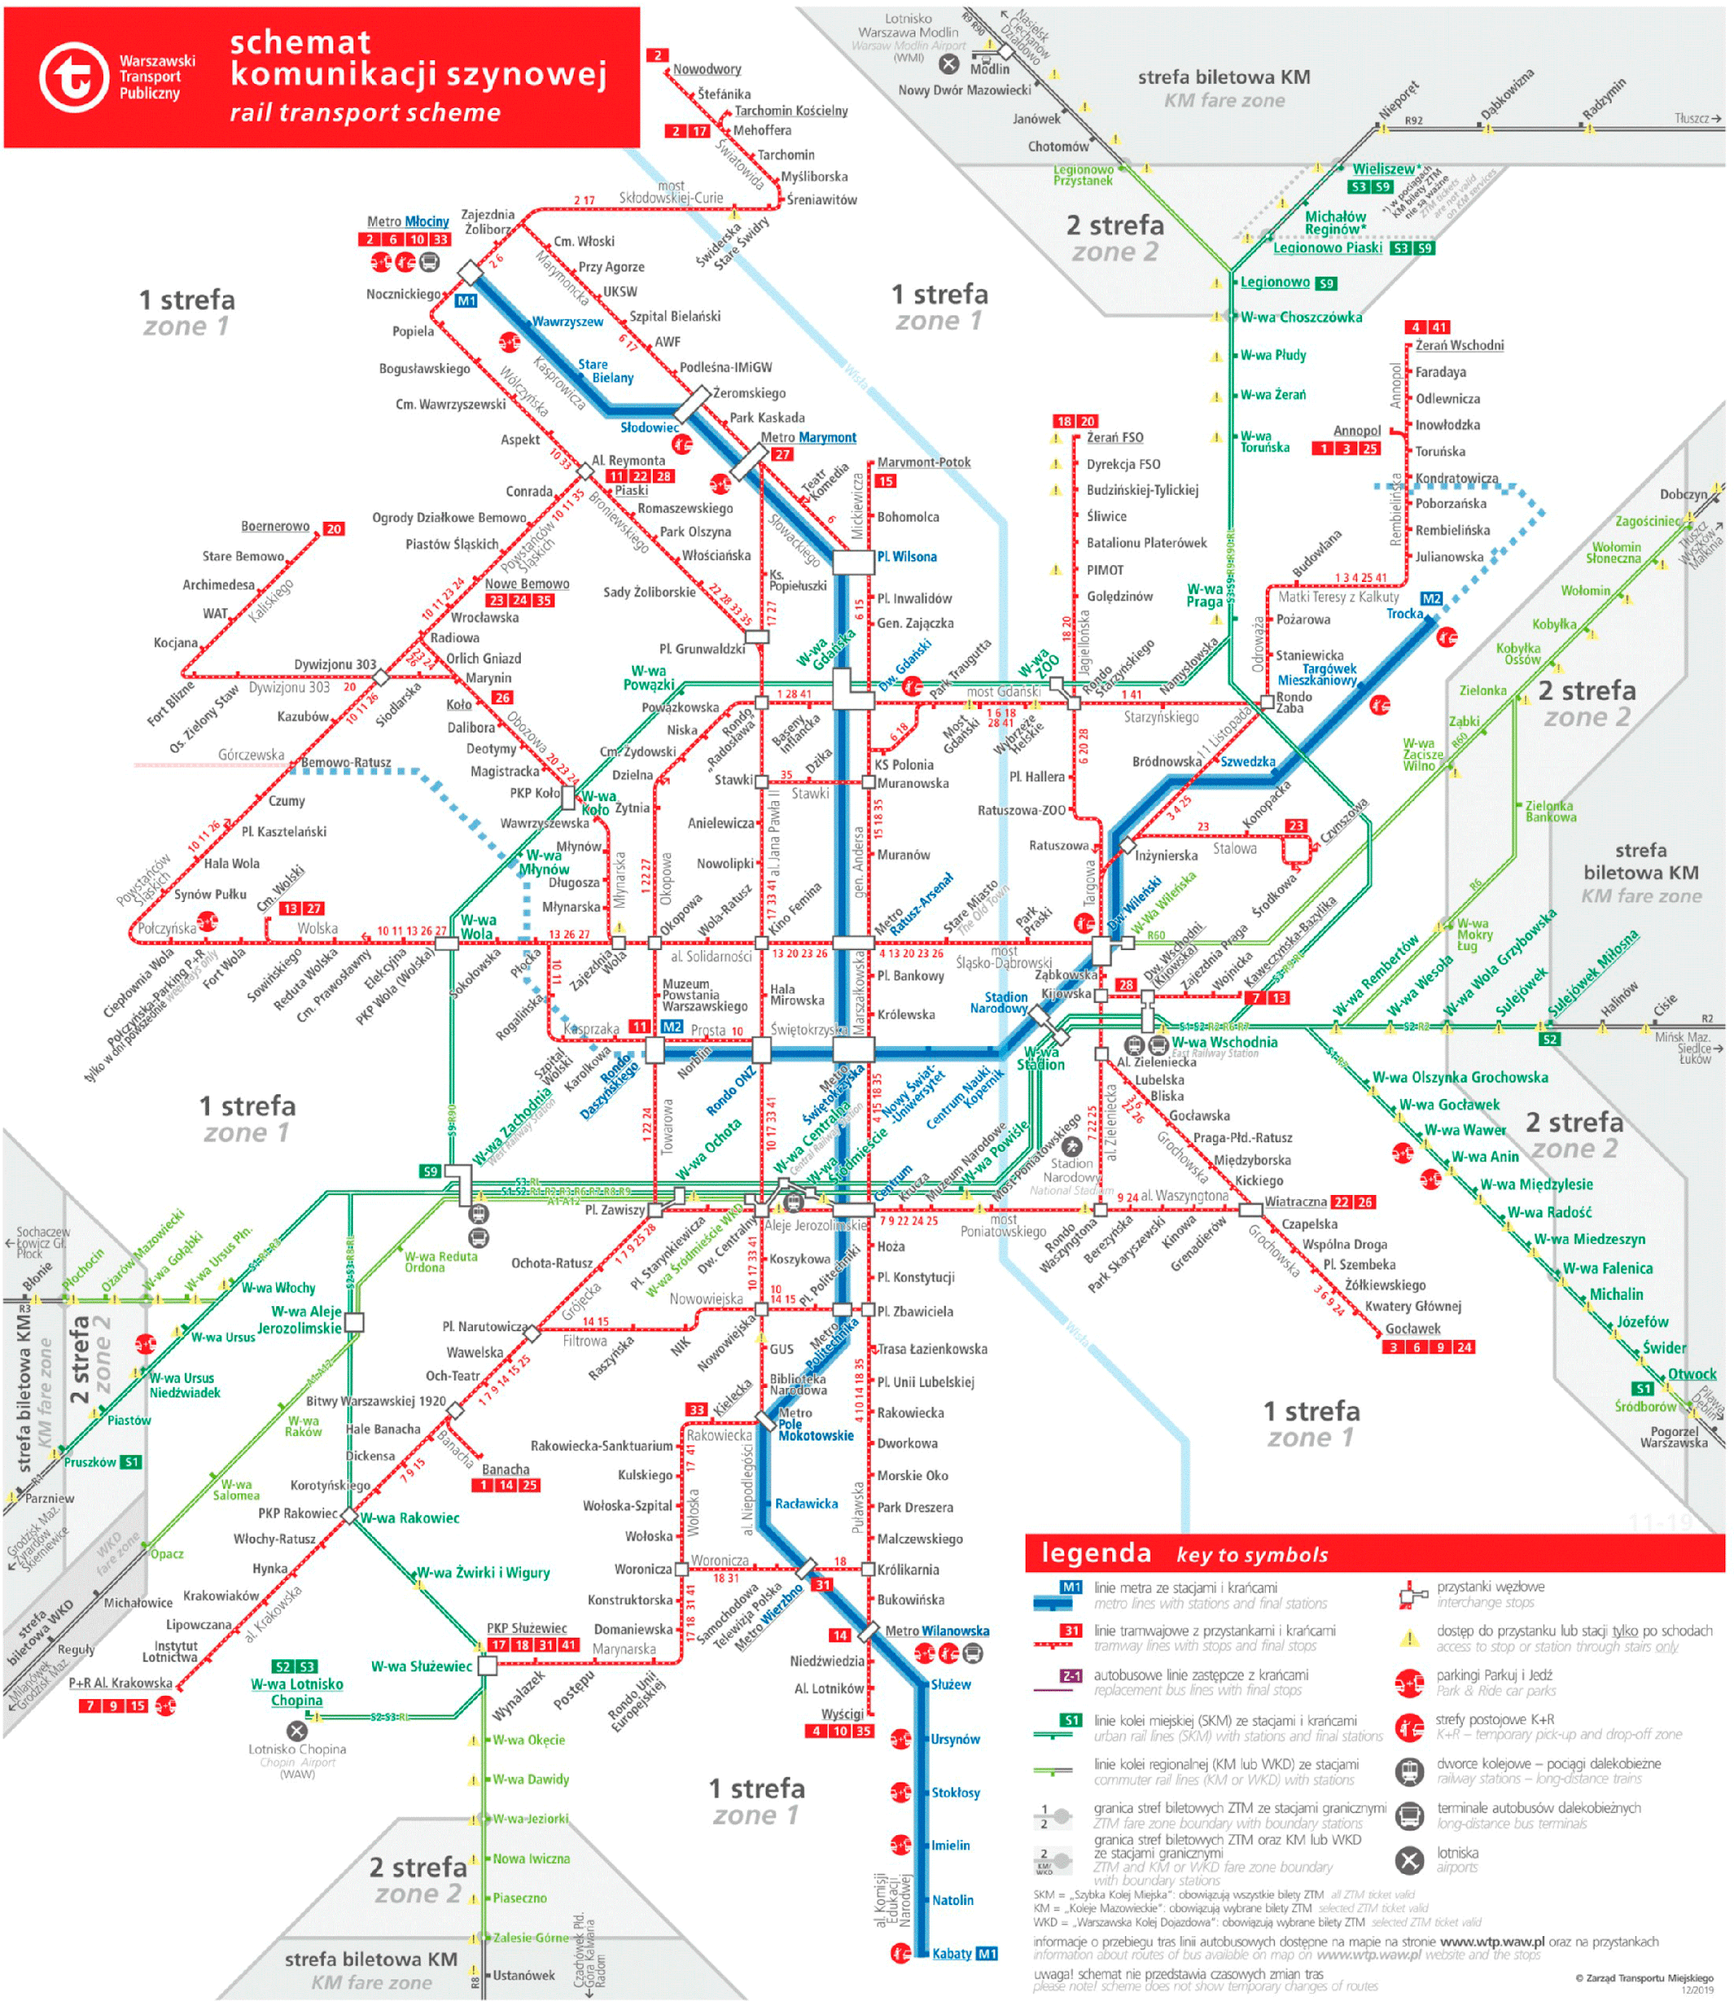


Core components: Abstraction
Abstracting the detailed view of Warsaw’s metro to create a much simpler and easier to read schema

Slide 34
Abstraction
When solving problems, we often need to ignore irrelevant details and focus only on what truly matters. This is where abstraction comes into play.
Abstraction is the process of simplifying a complex problem by focusing on its key features and ignoring unnecessary details. It helps make tasks easier to understand and manage. It means identifying what different elements have in common and setting aside the specifics that vary. This allows us to create general solutions that can be reused across multiple similar problems.
For example, when solving a puzzle, we might start by grouping pieces by color or edge shape, ignoring other features. This abstraction makes it easier to begin solving the problem. Later, we can look at more specific details to complete the picture.
This simplified metro map image on the right is an abstracted version of the original. It removes unnecessary details like street names or geographic accuracy and keeps only the essential elements, which are stations and connections, making it easier to understand how to get from one place to another.
Abstraction means focusing on what matters most. Like a simplified metro map, it helps learners navigate
problems by highlighting the essentials and ignoring distractions.

Slide 35

Abstraction
When we teach abstraction, we're helping students focus on what really matters. This skill is valuable for adults as it helps reduce overwhelm and improves decision-making. Eliminating distractions and identifying key elements makes it easier to understand problems and find practical solutions.
What trainers should know:
Abstraction helps learners focus on what’s essential and ignore distractions. This is especially helpful for adults who may get overwhelmed by too much information.
Teaching abstraction encourages learners to simplify problems and build solutions step by step, without needing to know every single detail from the start.
It's useful for developing problem-solving strategies that apply to multiple situations, saving time and effort.
Trainer activity idea
Use the daily routine of getting ready to leave the house for work or school. Walk learners through each step, then guide them to identify what truly matters. Ask:
    What are the essential steps you always do before leaving?
    What things could you skip and still be ready?
    How does focusing only on the key steps help save time or reduce stress?
Notes:
Encourage learners to focus on what’s essential. Abstraction helps them see the bigger picture without getting
lost in the details.

Slide 36
Abstraction
Example in real life:
When designing a house, you focus on the number of rooms and layout rather than getting bogged down by minor details like paint colors or furniture.
Example in software development:
When designing a website, abstraction involves focusing on core functionality (e.g., navigation, user login) before thinking about visual aesthetics
What trainers can do:
Encourage simplifying instructions: What do others need to know first? What can be left out without changing the goal?
Use role-play to compare overly detailed vs. clear communication and reflect on which is easier to follow.
Help learners filter information by asking: What’s the most important thing to focus on here? This encourages prioritizing key ideas.
Use abstraction to focus your learners’ attention on what really matters. Reducing unnecessary detail
improves clarity and communication.
Notes:
Example in business:
When writing a job description, abstraction helps by focusing on the key responsibilities and skills needed, instead of listing every possible detail of the role.

Slide 37

Core components: Algorithms
Look at the color of the traffic light
Is the color green?
Walk!
Wait!
A simple algorithm for pedestrians to cross the street

Slide 38
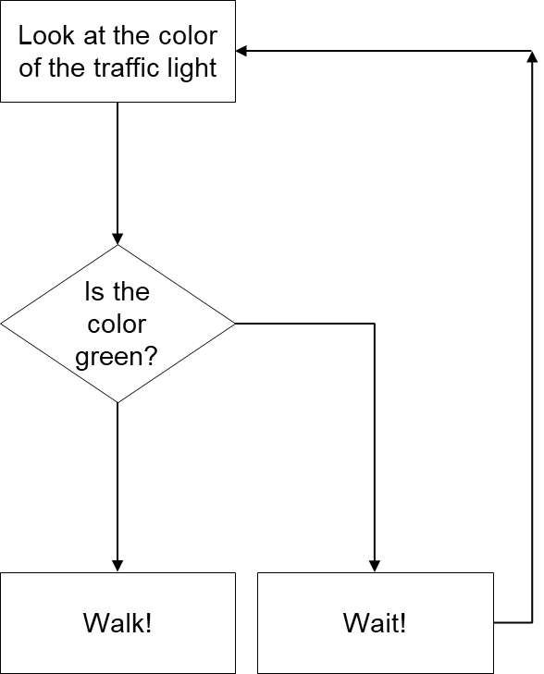
Algorithms
When we face a complex task, it’s not just about doing things, but doing them in the right order. That’s where algorithm design comes in. Algorithms give us a clear, step-by-step roadmap to follow, which helps us plan ahead and avoid getting lost in the process.
Algorithm design is the creation of a step-by-step process or set of rules to solve a problem or complete a task efficiently and accurately. It involves breaking down a problem into smaller, manageable steps to ensure optimal solutions and clear execution.
This flowchart is a simple algorithm for crossing the street. It checks the traffic light color and gives a clear instruction: “Walk” if it’s green, “Wait” if not. The steps repeat until it’s safe to go. It shows how algorithms use logical steps to guide actions.
Algorithm design is like writing down a recipe for solving a problem: easy to follow, step by step, so anyone can
repeat the process and get the same result.

Slide 39
Algorithms
Algorithm design helps learners approach tasks logically, knowing what comes next and how to reach a solution. When they know the steps, they feel more confidence while reaching the results.
What trainers should know:
Algorithm design promotes structured thinking. Learners become more precise and organized in their actions.
It helps develop planning skills, especially for tasks that require sequence and accuracy.
Algorithms make it easier for learners to explain their process and reflect on what worked (or didn’t).
Trainer activity idea
Ask learners to describe how they make a cup of coffee or tea. Have them write or say each step in order, as if explaining it to someone who has never done it before. Then ask:
    Are the steps clear and in the right order?
    Would someone be able to follow your instructions exactly?
    Is there anything missing that would cause confusion?

Slide 40
Algorithms
Example in real life:
A cooking recipe is an algorithm: it provides step-by-step instructions to achieve a specific result (the meal).
Example in technology:
Search engines use algorithms to fetch relevant results based on the keywords you input.
What trainers can do:
Break down everyday routines into ordered steps and ask: What happens if one step is skipped or done out of order?
Ask learners to write instructions for a simple task and test if others can follow them. Then ask: What was missing or unclear?
Use flowcharts to visualize decision-making processes, then ask: Where do choices affect the outcome?
Teach your students to think in steps. Clear instructions help them work more efficiently
and solve problems without getting stuck.

Slide 41
UNIT 5
Computational Thinking in the European educational structure
‹#›

Slide 42

Current landscape of CT in Europe
Computational Thinking has gained prominence in recent years in European educational discussions for its potential to develop important skills like critical thinking and problem-solving. However, its application has been concentrated in compulsory education at the primary and secondary levels, leaving adult education out of the discussion.
Since 2018, the European Commission has acknowledged the importance of Computational Thinking as a core component of 21st-century digital competence. Through the Digital Education Action Plan (2021–2027), the European Commission has actively promoted the integration of CT into education systems to better prepare citizens for digital transformation.
In most European countries, there is still no clear strategy for incorporating CT into adult training programs, even though it is a key competence for employability and digital citizenship.

Slide 43





Which European countries are leading in Computational Thinking?
Estonia
Finland
United
Kingdom
France
Germany
Estonia has been a pioneer in the region, integrating CT into the school system since 2012 and expanding initiatives into vocational training.
Finland, incorporated CT into the national curriculum in 2016 and has also launched pilot projects in adult and continuing education.
The United Kingdom made it mandatory in basic education in 2014 and has also promoted programs aimed at improving digital and computational skills among adults actively seeking employment.
France has implemented CT at the secondary education level since 2016 and has launched public digital training initiatives targeting workers and unemployed individuals.
Germany is integrating CT into technical and vocational education, with a particular focus on digital transformation within professional training programs.
Notes:
Estonia
Iniciativa ProgeTiger (2012): Estonia lanzó la iniciativa ProgeTiger en 2012, coordinada por la Fundación Informática para la Educación (HITSA) en colaboración con el Ministerio de Educación e Investigación, para apoyar a los docentes en la integración de la tecnología en sus clases. ​Programamos
Currículo educativo: El sistema educativo estonio, reconocido como uno de los mejores de Europa, incorpora desde edades tempranas el aprendizaje de robótica y competencias digitales, fomentando el pensamiento crítico y la resolución de problemas. ​Latest news & breaking headlines
2. Finlandia
Integración en 2016: Finlandia incorporó el pensamiento computacional en su currículo educativo en 2016, enfocándose en métodos innovadores como el aprendizaje basado en el juego y la resolución de problemas. ​
Formación docente: Se reconoce la necesidad de promover la formación de profesores como elemento clave para la efectiva integración del pensamiento computacional en los niveles educativos primarios y secundarios. ​ResearchGate
3. Reino Unido
Currículo obligatorio (2014): El Reino Unido fue el primer país en hacer obligatorio el pensamiento computacional en la educación primaria y secundaria en 2014. ​
Programa Barefoot Computing: Este programa apoya a los maestros de primaria en la aplicación del currículo de computación, proporcionándoles confianza y conocimiento para enseñar pensamiento computacional. ​INTEF
4. Francia
Integración en secundaria (2016): Francia incorporó el pensamiento computacional en las asignaturas de secundaria y bachillerato a partir de 2016. ​https://code.intef.es
Capacitación digital: Se han implementado iniciativas de capacitación digital dirigidas a trabajadores y desempleados para mejorar sus competencias en pensamiento computacional. ​
5. Alemania
Formación técnica y vocacional: Alemania ha integrado el pensamiento computacional en la formación técnica y vocacional, enfocándose en la digitalización y la educación continua. ​

Slide 44




Countries developing CT: Where are the first steps being taken?
Spain
Greece
Poland
Lithuania
Spain has started to integrate CT into the educational plans of some autonomous communities, especially at the compulsory education levels. On adult education there are isolated initiatives promoted by universities and community centers but no consolidated national policy yet.
Greece does not yet have a structured national program for CT, although academic institutions and NGOs have begun developing training experiences for adults, focusing on programming, educational robotics and logical thinking.
Poland has included Computational Thinking in the school curriculum, but its application for adults is mainly limited to vocational training projects or local initiatives in digital inclusion centers.
Lithuania, although increasingly focused on technology in its education system, is still taking its first steps to incorporate CT into non-formal or continuing education for adults.
Notes:
En españa: Aula mentor
An initiative offering online courses for adults. Includes courses in ICT, programming, and logic, fostering CT-related skills. Delivered through local
learning centers across Spain. https://www.aulamentor.es
Formación profesional para el empleo (FPE)
Publicly funded vocational training for unemployed and employed adults. Offers digital and tech skill courses that include CT-related content such as problem-solving, data
literacy, and basic programming. Coordinated through SEPE and regional employment services (e.g., SOC, Lanbide).
UNED & UOC Lifelong learning programs
Universities offering online, flexible courses targeted at adult learners. Topics like programming logic, algorithms, and digital thinking are included in micro-credentials and short
courses.
Community tech initiatives and libraries
Many local governments run tech literacy and coding workshops for adults via libraries or social centers, often including basic robotics, Scratch, or problem-solving activities to
encourage digital inclusion.

Slide 45
UNIT 6
Case study
and activities
‹#›

Slide 46

Case studies & good practices
Case study: smart traffic control system with Computational Thinking
Example:
A smart system was developed to ease traffic congestion on Tai Tam Road, Hong Kong.
Practice:
Using computational thinking, the system analyzed real-time traffic patterns through video analytics, adjusting traffic light timings based on vehicle queue lengths, resulting in double time savings.
Good practice:
The system applied pattern recognition and abstraction to identify congestion trends and adjust green light durations, reducing delays and improving traffic flow by automating key decisions.

Slide 47

Case studies & good practices
Case study: plant disease detection with Computational Thinking
Example:
A system was developed to detect plant diseases using image processing and machine learning techniques.
Practice: The system used abstraction to focus on key disease patterns, and automation allowed for faster, more accurate disease detection using Support Vector Machines (SVM) combined with Active Contour edge detection
Good practice:
Using computational thinking, the process was broken down into edge detection and classification, applying pattern recognition for image analysis and decomposition for disease identification.

Slide 48

Activity 1 – Decomposition
Break a complex task into smaller, manageable parts.
Example: Planning a trip to Barcelona (choosing a destination, booking flights, making an itinerary).
Objective: Understand how breaking down a problem simplifies its solution
Notes:
Solution:
Choose travel dates: 7 days in May.
Book flights: Find round-trip flights to Barcelona (El Prat Airport).
Arrange transportation: Use the Aerobus from the airport; buy a metro pass for the city.
Find accommodations: Book a hotel near La Rambla.
Create itinerary:
Day 1: Explore Gothic Quarter.
Day 2: Visit Sagrada Familia
Day 3: Relax at Barceloneta Beach.
Day 4: Montjuïc and Magic Fountain.
Day 5: Las Ramblas, Casa Batlló.
Day 6: Camp Nou, Poble Espanyol.
Day 7: Shopping at Passeig de Gràcia.
Book tickets: Sagrada Familia, guided tours

Slide 49
Activity 2 – Pattern Recognition
Analyze the following number sequence:
Sequence A: 2, 4, 7, 11, 16, ...
Sequence B: 2, 4, 8, 16, 32, ...
Sequence C: 1, 1, 2, 3, 5, 8, 13...
Identify the pattern in how the numbers change.
Notes:
Solution:
Sequence A: 2, 4, 7, 11, 16, ...
Solution: The difference between the numbers increases by 1 each time (4 - 2 = 2, 7 - 4 = 3, 11 - 7 = 4, etc.).
Pattern: Add increasing increments (2, 3, 4, 5, ...).

Slide 50
Activity 3 – Abstraction
Summarize a movie plot
Pick any movie you know well (e.g., a superhero movie).
Abstract the plot by focusing on the core elements:
  Main character's goal
  Key conflicts
  Resolution
Notes:
Solution:
Movie: The Lion King
Main character's goal: Simba, the lion cub, must reclaim his rightful place as king of the Pride Lands after his father's death.
Key conflicts: Scar, Simba's uncle, betrays and kills Mufasa, taking over the Pride Lands.
Simba runs away, growing up in exile, while Scar rules unjustly.
Resolution: Simba returns to the Pride Lands, confronts Scar, and defeats him, restoring peace and balance to the kingdom.

Slide 51
Activity 4 – Algorithm Design
Develop step-by-step instructions to solve a task.
Example: Create an algorithm to make a sandwich(pick ingredients, slice the bread, etc.)
Objective: Illustrate how precise steps can solve problems systematically
Notes:
Solution:
Start
Pick ingredients: Bread, butter, ham, cheese, lettuce.
Slice the bread: Take two slices of bread.
Spread condiments: Apply butter to one side of each slice.
Add fillings: Place ham, cheese, and lettuce on one slice of bread.
Assemble the sandwich: Place the second slice of bread on top.
Cut the sandwich: Slice the sandwich in half, if desired.
End

Slide 52
SUMMARY
Computational Thinking is a structured way of solving problems that draws from core concepts in computer science but applies far beyond it. In this module, we explored what CT means, its origins, and why it matters, especially for adult learners.
We examined how CT helps us break down complex challenges, recognize patterns, focus on essential information and design logical, step-by-step solutions. By comparing how computers and humans think, we gained insight into CT as a bridge between logic and creativity.
CT is not just about programming, it’s a mindset. For adult education, it offers practical value: supporting autonomy, critical thinking, and decision-making across everyday life, work, and learning. As trainers, understanding CT empowers us to help learners build confidence and adapt to a fast-changing world.

Slide 53

CALL TO ACTION:
Reflect on what you’ve learned:
How can you help learners use decomposition, patterns, abstraction, and algorithms in their daily lives?
What real-world activities could you adapt to introduce these CT concepts with low-qualified adult learners?
How will you model computational thinking in your own teaching to help learners see its value?

Slide 54
GLOSSARY
Computational Thinking or CT: Solving problems like a computer would, step-by-step.
Decomposition: Breaking a big problem into smaller parts.
Abstraction: Focusing only on the important details.
Pattern Recognition: Spotting trends or things that repeat.
Algorithm: A set of instructions to complete a task.
Iteration: Repeating a process to improve it.
Unplugged Activities: Learning CT without screens using games, puzzles, etc.
Debugging: Finding and fixing errors in a process.
Soft Skills: Non-technical abilities that help people work well with others and adapt to challenges.
Gamification: Using game elements (like points or challenges) in learning.
Digital Literacy: Knowing how to use digital tools safely and effectively.
Inclusion: Making learning accessible to everyone, no matter their background.
Scaffolding: Supporting learners step-by-step so they can gradually do more on their own.

Slide 55
References
Aho, A. V. (2011). Computation and computational thinking. Ubiquity, 2011(January), 1–1. https://dl.acm.org/doi/10.1145/1922681.1922682
Tedre, M., & Denning, P. J. (2016). The long quest for computational thinking. In Proceedings of the 16th Koli Calling Conference on Computing Education Research (pp. 120–129). ACM. https://dl.acm.org/doi/10.1145/2999541.2999542
Wing, J. M. (2008). Computational thinking and thinking about computing. Philosophical Transactions of the Royal Society A: Mathematical, Physical and Engineering Sciences, 366(1881), 3717–3725. http://denninginstitute.com/pjd/PUBS/long-quest-ct.pdf
Smart City Consortium. (n.d.). Case studies. Logistics and Supply Chain MultiTech R&D Centre. https://www.lscm.hk/eng/channel.php?channel=case-stcs
Smart City Blueprint for Hong Kong. (n.d.). Smart City initiatives. https://www.smartcity.gov.hk/
Grover, S., & Pea, R. (2013). Computational thinking in K–12: A review of the state of the field. Educational Researcher, 42(1), 38–43. https://journals.sagepub.com/doi/10.3102/0013189X12463051
Bocconi, S., Chioccariello, A., Dettori, G., & Kampylis, P. (2016). Developing computational thinking in compulsory education: Implications for policy and practice. Joint Research Centre – European Commission. https://op.europa.eu/en/publication-detail/-/publication/093eadcc-c820-11e6-a6db-01aa75ed71a1/language-en
European Commission. (2021). Digital Education Action Plan 2021–2027: Resetting education and training for the digital age. https://education.ec.europa.eu/focus-topics/digital/digital-education-action-plan
Computational Thinking. Resources and strategies for teaching computational thinking. https://computationalthinking.org/

Slide 56
Activity 4 –
Algorithm Design
Activities - Solutions
Activity 1 – Decomposition
Activity 2 –
Pattern Recognition
Activity 3 –
Abstraction
Choose travel dates: 7 days in May.
Book flights: Find round-trip flights to Barcelona (El Prat Airport).
Arrange transportation: Use the Aerobus from the airport; buy a metro pass for the city.
Find accommodations: Book a hotel near La Rambla.
Create itinerary:
Day 1: Explore Gothic Quarter.
Day 2: Visit Sagrada Familia
Day 3: Relax at Barceloneta Beach.
Day 4: Montjuïc and Magic Fountain.
Day 5: Las Ramblas, Casa Batlló.
Day 6: Camp Nou, Poble Espanyol.
Day 7: Shopping at Passeig de Gràcia.
Book tickets: Sagrada Familia, guided tours
Sequence A: 2, 4, 7, 11, 16, ...
Solution: The difference between the numbers increases by 1 each time (4 - 2 = 2, 7 - 4 = 3, 11 - 7 = 4, etc.).
Pattern: Add increasing increments (2, 3, 4, 5, ...).
Movie: The Lion King
Main character's goal: Simba, the lion cub, must reclaim his rightful place as king of the Pride Lands after his father's death.
Key conflicts: Scar, Simba's uncle, betrays and kills Mufasa, taking over the Pride Lands.
Simba runs away, growing up in exile, while Scar rules unjustly.
Resolution: Simba returns to the Pride Lands, confronts Scar, and defeats him, restoring peace and balance to the kingdom.
Start
Pick ingredients: Bread, butter, ham, cheese, lettuce.
Slice the bread: Take two slices of bread.
Spread condiments: Apply butter to one side of each slice.
Add fillings: Place ham, cheese, and lettuce on one slice of bread.
Assemble the sandwich: Place the second slice of bread on top.
Cut the sandwich: Slice the sandwich in half, if desired.
End

